Slide 1
PRE-APPLICATION CONFERENCE MBE Equity Multiplier Notice of funding opportunity announcement MBDA-OBD-2021-2006868 June 4, 2021 2:00 – 3:00pm EDT

Slide 2
overview
Teleconference Protocol
Important Dates
MBDA Alignment
Notice of Funding Opportunity Announcement
Program Objectives
Program Priorities
Program Authority
Award Information
Eligibility Information
Application and Submission Information Management (SAM)
Submission Dates and Times
Funding Restriction
Other Submission Requirements
Application Review Information
Reporting
Agency Contact
Other Information
2

Slide 3
Teleconference Protocol
Phones should be placed on mute
Questions are prompted at designated times and coordinated through conference operator
Teleconference focused on MBE Equity Multiplier Project
Keep questions relevant to the topic at hand
Avoid duplicating questions
3

Slide 4
Important Dates
CFDA #11.802
Competition
Published Date: May 27, 2021
Deadline Date: June 30, 2021at 11:59 P.M., E.D.T.
Electronic applications only
Anticipated Award
Start Date: September 1, 2021
4

Slide 5
MBDA Strategic Alignment
Vision
MBDA is the champion for minority business enterprises
Mission
To promote the growth of 11 million minority business enterprises
Strategy
To increase the number of MBEs that gross $1M+ in revenues

Slide 6
Program objectives
The Minority Business Development Agency (MBDA), a bureau of the U.S. Department
of Commerce, will provide Federal assistance to support innovative projects seeking to
promote and ensure the inclusion and use of minority enterprises.
The MBDA Minority Business Enterprise (MBE) Equity Multiplier Project will facilitate technical assistance to MBEs related to accessing capital. In accordance with Executive Order 11625 and 15 U.S.C. § 1512, MBDA is soliciting competitive applications from eligible organizations for the operation of MBDA MBE Equity Multiplier Projects as described in this Broad Agency Announcement (BAA). MBDA anticipates awarding approximately one (1) individual cooperative agreement pursuant to this BAA.
6

Slide 7
Program Priorities
MBDA anticipates making one (1) award under this announcement, with a federal funding
amount of approximately $300,000.
1. Agency Requirements for the Project
a) Alignment to MBDA Mission
b) Service Location
c) Services
d) Performance
e) MBE Service Recipients (see printed Notice of Funding Opportunity)
7

Slide 8
Program Priorities
Performance Measures and Goals – In order to remain consistent with the Agency’s mission, applications should allow for the measurement of the growth of MBEs, especially as it relates to equity growth. Applicants should plan projects that allow them to set measures and goals in the areas noted below, in addition to any others, and then to report their performance based on the goals and measures set. These goals shall determine performance achievement and outcomes that result in direct benefit(s) to the clients served and alignment to the program priorities.
8

Slide 9
WINNING THE FUTURE
Minority business development agency’s
NOTICE OF FUNDING OPPORTUNTY
Pre Award Conference
MBDA Equity Multiplier Notice of Funding Opportunity
June 4, 2021
Carmen West & Jean Robert Baguidy
Senior Advisors for Capital Access

Slide 10
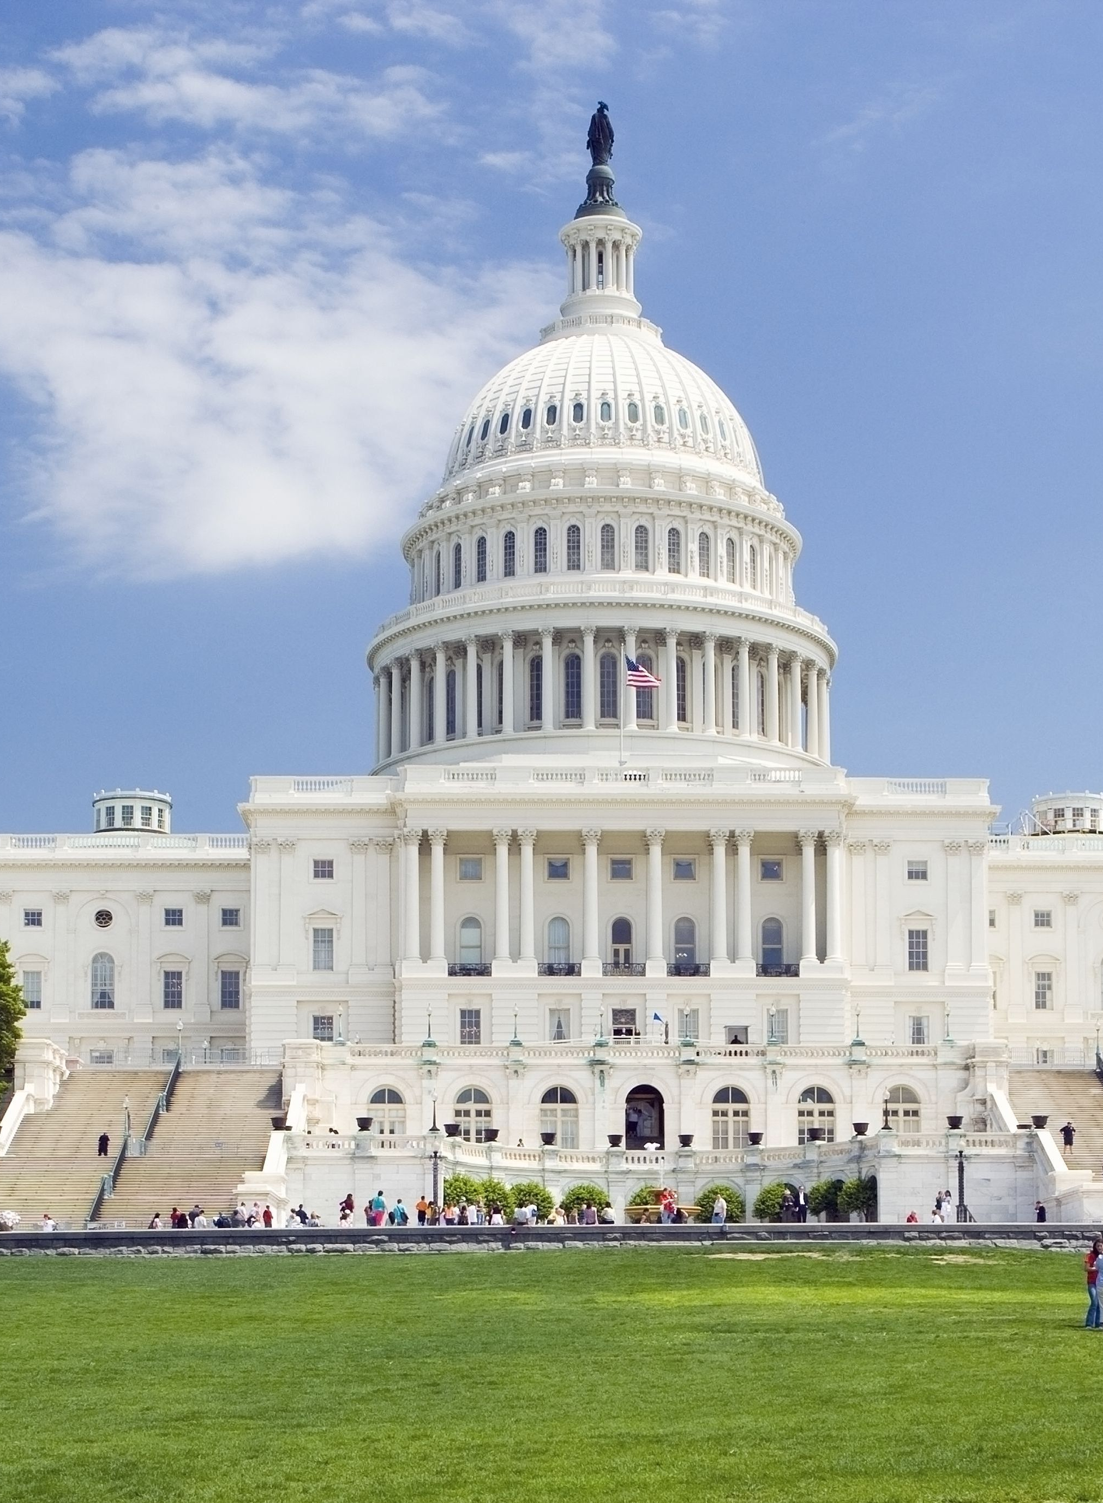
MBDA APPROPRIATIONS
CONSOLIDATED APPROPRIATIONS ACT FY2021
CARES ACT OF FY 2020
MBDA supports the minority business community through the deployment of federal funding under sections 1107 and 1108 of the Coronavirus Aid, Relief, and Economic Security (CARES) Act
Congress authorized $10 million for education, training, and advising small and minority business enterprises in their recovery from the effects of the COVID-19 crisis
30 Grants awarded to 24 existing MBDA Business and Specialty Centers, plus 5 national minority chambers of commerce
Period of performance is June 1, 2020 through May 31, 2021
MBDA continues to support the minority businesses through the deployment of COVID Relief funding under title III, section 323(d)(B) of the Consolidated Appropriations Act
Congress authorized $25 million for assisting minority business enterprises to prevent, prepare for and respond to coronavirus, in their recovery from the effects of the COVID-19 crisis
Anticipate 30 Grants will be awarded to 30 existing MBDA Business and Specialty Centers
Period of performance projected is July 1, 2021 through June 30, 2022
https://www.mbda.gov/news/press-releases/2020/06/minority-business-development-agency-awards-10m-federal-funding-under

Slide 11
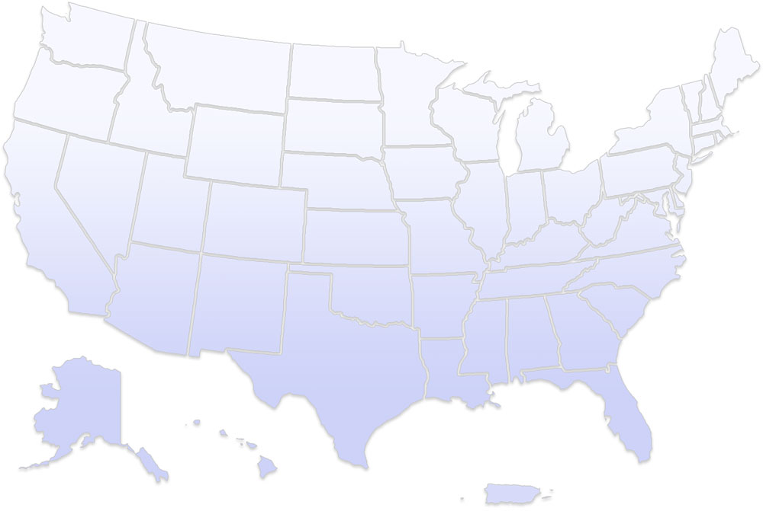
MBDA CURRENT INVESTMENTS
National Network of MBDA Business Centers, Specialty Centers and National Minority Chambers
BUSINESS CENTERS
Arizona
Phoenix MBDA Business Center
California
Pasadena MBDA Business Center
San Jose MBDA Business Center
Colorado
Denver MBDA Business Center
District of Columbia
Washington DC MBDA Business Center
Georgia
Atlanta MBDA Business Center
Hawaii
Honolulu MBDA Business Center
Illinois
Chicago MBDA Business Center
Maryland
Baltimore MBDA Business Center
Michigan
Detroit MBDA Business Center
Minnesota
Minneapolis MBDA Business Center
Missouri
St. Louis MBDA Business Center
New York
Manhattan MBDA Business Center
South Bronx MBDA Business Center
Pennsylvania
Philadelphia MBDA Business Center
Puerto Rico
Puerto Rico MBDA Business Center
South Carolina
Columbia MBDA Business Center
Tennessee
Memphis MBDA Business Center
Texas
Dallas MBDA Business Center
El Paso MBDA Business Center
San Antonio MBDA Business Center
Washington
Tacoma MBDA Business Center
SPECIALTY EXPORT CENTERS
California
Sacramento MBDA Export Center
Florida
Miami MBDA Export Center
MINORITY CHAMBERS OF COMMERCE
District of Columbia
National Asian & Pacific Islander American Chamber of Commerce & Entrepreneurship
U.S. Hispanic Chamber of Commerce
U.S. Black Chamber
New York
National Urban League
Detroit, MI
National Business League
Distribution: 23 cities in 17 states, and 1 US territory

Slide 12
GRANT FUNDS – IMPACT
Impacts in Economically Distressed and Rural Areas
Small & Minority Businesses Served
Loans
& Grants
Assisted securing 1,256 awards totaling over $21.2M in Federal Loans (including PPP, EIDL, Disaster, state, county & other)
Over 538K educated and informed and 2,050 success stories reported
5,118 small and minority businesses were assisted in designated distressed areas
Performance data is ongoing and not audited.
Types of services may range from information broadcasts to online training to direct consulting services.
Types of success stories can range from debt payment deferral to loan or contract awarded to firm to jobs created/retained
Data represents June 1, 2020 through February 28, 2021.

Slide 13
OVERALL MBDA YTD IMPACT
All MBDA Programs – First 9 months (Q1+Q2+Q3) UNDER COVID
June 1, 2020 – February 28, 2021
Standard MBDA Business & Specialty Center Funding
CARES Act 2020 Funding
Overall Impact
Loans
& Grants
Loans
YTD Totals
+
=
Outcomes
1,443 awards
$74.2M
Impact
Nearly 1,700 Jobs Created & Retained
Assisted securing 1,256 awards totaling over $21.2M in Federal Loans (including PPP, EIDL, Disaster, state, county & other)
Assisted securing 187 awards totaling over $53M in Federal Loans (including PPP, SBA & other)

Slide 14
OUR
MISSION
OUR
GRANTS
We establish cooperative agreements with national, regional, and local organizations to provide expert-level technical support and consulting services designed to increase capacity and facilitate growth in domestic and international markets.
Program Priorities Cont’d
MBDA stimulate the growth of minority-owned firms.
OUR
APPROACH
OUR
ECOSYSTEM
The primary drivers of this project are (i) capacity
building and venture capital readiness, (ii) increasing access to equity and venture
investment and investors, (iii) technical business services; and (iv) job creation.
We facilitate ecosystem development by leveraging partnerships with and connecting organizations that share our mission—government, financial institutions, MBE advocates, HBCU/minority-serving institutions, economic development organizations, and more.

Slide 15
Program Priorities Cont’d
The MBE Equity Multiplier Project aims to create a more diverse economy and drive economic prosperity for founders of color.
This program supports competitive proposals that seek to support entrepreneurship and accelerate MBE growth nationally via technical assistance for equity investment.
What is the
MBE Equity Multiplier Program ?
Competitive proposals will outline how the project will strengthen
economic competitiveness through increasing the flow of equity capital to minority communities and leverage the strengths of partnerships to help create new enterprises, commercialize technology, and create jobs

Slide 16
Program Intentions
This program is intended to provide direct technical assistance to MBEs that receive or are seeking equity investment or a hybrid model of investment.
Program Priorities Cont’d
Applicant Potential Activities
Applicants of this BAA will provide technical assistance to MBEs, including, for example: evaluation of companies with high growth as a central factor of their investment strategy; technical business services and investor engagement activities; pitch decks, financial models, company profiles, financial related legal support, financial/equity agreements, term sheets and closing documents, due diligence, market analyses, valuations; customer acquisitions; business
acquisitions; merger assistance
This program leverages community resources and investment and maximizes opportunities for the development of emerging, high growth minority entrepreneurs in a myriad of industries.

Slide 17
KEY POINTS
Funding can NOT go directly to MBEs.
33% Match Required
An applicant can only apply once and meet the eligibility requirements

Slide 18
Program Authority
In the Fiscal Year 2021 appropriations bill, Congress authorized the Department of Commerce through MBDA to provide funding to foster, promote and develop minority business enterprises through grants, contracts, and other agreements with public or private organizations. See Consolidated Appropriations Act of 2021, Pub. L. No. 116-260 (Dec. 27, 2020). MBDA is authorized pursuant to Executive Order 11625 to provide financial assistance to public and private organizations so that they may render technical and management assistance to minority business enterprises and defray all or part of the costs of pilot or demonstration projects conducted by public or private agencies or organizations which are designed to overcome the special challenges of minority business enterprises.
18

Slide 19
Award Information
A. Funding Availability
MBDA expects to expend approximately $300,000 in fiscal year (FY) 2021 funds for one (1) financial assistance award under this BAA. MBDA anticipates that up to $300,000 will be available in FY 2022 to support continuation funding for this project. The funding amounts referenced in this NOFO are subject to the availability of appropriated funds.
Publication of this BAA does not obligate the U.S. Department of Commerce or MBDA to award any specific cooperative agreement or to obligate all or any part of available funds.
19

Slide 20
Award Information Cont’d
B. Project/Award Period
MBDA will issue awards for a two-year term, to be funded one year at a time, from September 1, 2021 through August 31, 2023. Funding for the second year is contingent upon satisfactory performance in the prior year (Year 1) based on proposed goals and maintenance of strategic program priorities.
C. Type of Funding Instrument
Selected applicant(s) will receive funding through a grant under this Announcement. After the award is made, MBDA staff may assist the project by means of a post-award conference, ongoing collaboration and communication.
20

Slide 21
Eligibility Information
A. Eligible Applicants
Eligible applicants include: For-profit entities (including but not limited to sole proprietorships, partnerships, limited liability companies, and corporations), non-profit organizations, institutions of higher education, commercial organizations, state and local government entities, Tribal governmental entities, and quasi-government entities.
21

Slide 22
Eligibility Information
B. Cost Sharing or Matching Requirement
Applicants have a 33% cost share requirement. Applicants must demonstrate at the time of application, a matching share of 33% of the total project. Funds from other financial assistance awards may be used only if allowed by statute. Applicants must submit a commitment letter from any organization providing matching funds. In-kind contributions may be used but must contribute directly to the project (such as equipment or space). A provider of matching share may not serve as a contractor under the award for which it provides a matching share. The entity providing a matching share may not be paid by the
award recipient with award funds. The matching share cannot be provided as an investment
into MBEs.
C. Other Criteria that Affect Eligibility
None
22

Slide 23
Application and Submission Information
A. Address to Request Application Package
All application materials and forms are available at the grants.gov website (http://www.grants.gov). Helpful competition materials such as FAQs can be found on the MBDA Internet Portal (www.mbda.gov).
B. Content and Form of Application: General Requirements. The application must provide sufficient information for the agency to make a determination of merit of the proposal. Each applicant’s proposal must describe in detail the programmatic deliverables that address “Agency Requirements for the Center” (See Section I.B.1 above) refer to NOFO for specific details.
a. . Content Requirements: A Complete Application
Title Page (One (1) page limit)
Table of Contents (One (1) page limit)
Applicant Narrative (Ten (10) page limit)
Supporting Documents (Three (3) page limit)
Standard Forms (SF) and Budget Narrative (Complete 424A’s for each year). Please refer to the application package available through www.Grants.gov. Please review each form to determine which is required with a submission. Each applicant may not be required to submit all forms listed, depending on the project type or the applicant type.
Format Requirements: All pages should be single-spaced and should be composed in at least 11-point font with one-inch margins on 8-1/2 inch x 11 inch paper. The total proposal shall not exceed 20 pages, including the title page, table of contents, applicant narrative, literature cited, budget narrative, letters of support or letters of commitment (if any), and organizational structure.
23

Slide 24
Unique Entity Identifier and System for Award Management (SAM)
Each applicant (unless the applicant is eligible for an exemption under 2 CFR §
25.110(b) or (c), or an exception approved by the MBDA under 2 CFR § 25.110(d)) is
required to:
1. Register in SAM before submitting an application;
2. Provide a valid unique entity identifier in the application; and,
3. Continue to maintain an active SAM registration with current information at all times
during which it has an active Federal award or an application or plan under consideration by
MBDA (or any other Federal agency).
MBDA may not make a Federal award to an applicant until the applicant has complied with
all applicable unique entity identifier and SAM requirements. If an applicant has not fully
complied with the requirements by the time MBDA is ready to make the award, MBDA may
determine that the applicant is not qualified to receive a Federal award and use that
determination as a basis for making an award to another applicant.
24

Slide 25
Submission dates and times
All proposals must be received on or before June 30, 2021 at 11:59:59 pm Eastern Time (E.T). Applications may be submitted starting from the publication date of this NOFO up to the deadline above. Applications received after this time will not be reviewed or considered for funding. Applications must be submitted electronically via www.grants.gov.
The electronic submission will receive a date and time stamp at www.grants.gov and will be processed after it is fully uploaded. Applicants should anticipate receiving confirmation of successful submission within forty-eight (48) hours. It is imperative that applicants obtain this confirmation as proof of successful submission. Waiting to submit an application until the end of the competition period puts an application at risk; be sure to allow ample time.
25

Slide 26
Funding Restriction
Applicants requesting an indirect cost rate (IDC) are required to submit a copy of their current and signed indirect cost rate agreement with the application package. If an applicant does not have a current Facilities and Administrative (Indirect) Cost Rate Agreement that was negotiated and approved by the Department of Commerce (or by the applicable cognizant Federal agency), please provide a statement to this effect. The applicant must prepare and submit a cost allocation plan and rate proposal or a negotiated indirect cost rate as required by 2 CFR Part 200 “Uniform Administrative Requirements,
Cost Principles and Audit Requirements for Federal Awards.” See 2 CFR § 200.414. The allocation plan and the rate proposal must be submitted to MBDA (or applicable cognizant Federal agency) within ninety (90) days from the award start date.
Alternatively, in accordance with 2 CFR § 200.414(f), a non-Federal entity that has never received a negotiated indirect cost rate may elect to charge a de minimis rate of 10 percent of modified total direct costs. Applicants proposing a 10 percent de minimis rate pursuant to 2 C.F.R. § 200.414(f) should note this election as part of the budget and budget narrative portion of the application.
Indirect costs proposed under the award must be clearly identified as a separate budget line item.
26

Slide 27
Other submission requirements
The time it takes to completely upload an application will vary depending on a number of factors, including the size of the application, the speed of the applicant’s Internet connection, and the time it takes www.grants.gov to process the application. If www.grants.gov rejects the application, the applicant must resubmit the entire application and receive a date and time stamp from www.grants.gov. The www.grants.gov time stamp will be considered the date and time of submission receipt. Before beginning to apply through www.grants.gov, please review the application instructions posted at
www.grants.gov and in this NOFO.
Grants.gov Registration: To submit an application through www.grants.gov, you must register for a user ID and password. This process can take between three to five business days and up to four weeks if all steps are not completed correctly.
Electronic Submission: The electronic submission date is the date that applications have been submitted electronically and received by www.Grants.gov. Proof of timely submission shall be the official date and time that www.Grants.gov receives your application.
3. Returning Grants.Gov Users: Organizations already registered with Grants.gov do not need to re-register, but the organization must maintain a current System for Award Management (SAM) registration (formerly Central Contractor Registration (CCR)). If the applicant’s SAM registration is not up-to-date the application will not be accepted by
Grants.gov. An applicant’s CCR username will not work in SAM
27

Slide 28
Application review information
Evaluation Criteria: The successful applicant will possess experience that is relevant and related to the area(s) covered by MBDA’s Priorities (see section I.B.). Each application will be evaluated based on “Agency Requirements for the Center” (see section I.B.1), and the evaluation criteria included below. It is also anticipated (although not mandatory) that the mission of the successful applicant organization will align with the mission of MBDA. The successful
applicant also will ensure alignment of budget, resources, objectives, outcomes or goals, and timelines to accomplish the proposed project.
Applicant Narrative (65 points)
Project Description (up to 25 points)
Applicant Capability (up to 25 points)
Project Goals and Objects (up to 15 points)
Applicant Budget (35 points)
Budget Breakdown (up to 15 points)
Budget Narrative (up to 20 points)
Total Available Applications Points (100)
All applications must adhere to the submission guidelines provided in this section and section IV.B.1.a), “A Complete Application.” Omissions will result in the deduction of points from the final score according to the table below up to and including disqualification of the entire application.
Mandatory Item Failure to Adhere Shall Result In
Title Page (5 Point Deduction)
Table of Contents (5 Point Deduction)
Applicant Narrative (Disqualification)
Budget Narrative (Disqualification)
Required Standard Forms (SF) and Attachments (Disqualification)
All project proposals will be evaluated and applicant(s) will be selected based on the level at which the proposal addresses the evaluation criteria above, less any points deducted for failure to include the mandatory items noted above.
28

Slide 29
Application review information Continued
Review and Selection Process
Initial Screening: Prior to the formal review process, each application will receive an initial administrative screening to ensure that all required forms, signatures, and documents are present. An application will not be evaluated by the review panel if: a) the application is received after the closing date; b) the application package is not complete; the project synopsis/description fails to address program objectives
MBDA Merit Review Panel: Each responsive application will receive an independent, merit review by a panel qualified to evaluate the applications submitted based on the published criteria. The review panel will consist of at least three (3) individuals, all of whom could be a combination of full-time federal employees and/or non-federal civilians at least one of whom will be an MBDA employee. Applications will be ranked by averaging the scores of all reviewers for each application. The Chairperson of the merit review panel will be responsible for averaging reviewers’ scores, collating reviewer comments, and completing an evaluation. Applications that receive an overall average of 75 points or more will be considered for funding. Applications receiving an average score of 60 to 74 points will be given a second consideration for funding if the panel requests additional information or clarification and if the applicant is able to respond to the panel’s request for additional information/clarification within an allotted time. Thereafter, the merit review panel may rescore these applications.
Selection Factors: The ranked applications receiving an initial average score of 75 points or higher or applications given a second consideration (as noted above) will be forwarded to the Program Manager for review and consideration of the merit panel evaluation and overall average score. Upon completion, the Program Manager will forward funding recommendations to the Selecting Official.
Anticipated Announcement and Award Dates: MBDA anticipates that the awards under this BAA will be made with start dates of September 1, 2021. Successful applicants may be eligible for pre-award costs.
29

Slide 30
Reporting
The project is required to provide the following reports:
a) Financial Reports –The financial report shall include details on the use of Federal
funds and contributions of non-Federal funds (if proposed). The financial reports are to be
submitted to the Department of Commerce via Grants Online on a semi-annual and annual
basis. The semi-annual and annual reports are due forty-five (45) days after the end of the
initial six-month period in each funding period. The final report is due within one hundred twenty (120)
days after the expiration of each funding period.
b) Progress Report – Progress reports are to be submitted to the Department of Commerce
via Grants Online on a semi-annual and annual basis. The semi-annual report is due forty-five
(45) days after the end of the initial six-month period in each funding period. The final
report is due within one hundred twenty (120) days after the expiration of each funding period.
The semi-annual and annual reports must include data and information to determine project
progression and success. MBDA will rely on these reports, data, and information as evidence
for future program design, policy recommendations, and/or statistical purposes.
Note: failure to submit reports in a timely manner may result in MBDA award enforcement
and/or delayed access to Federal funds.
30

Slide 31
Agency contact
Mrs. Nakita Chambers
MBDA Program Manager
U.S. Department of Commerce
Email: nchambers@mbda.gov
Tel: 202-482-0065
31

Slide 32
Other information
Post Award Teleconference
National Minority Enterprise Development Week Conference (travel for year 2 ONLY)
MBDA National Training Conference (travel for years 1 and 2)
NOAA Grants Management Workshop (virtual)
Collaboration with MBDA
Past Performance and Non-Compliance with Award Provisions
Limitation of Liability
Audit Costs
Right to Use Information
Freedom of Information Act Disclosure
32

Slide 33
Thank you
Thank you for your participation & Good luck!
33

