Slide 1
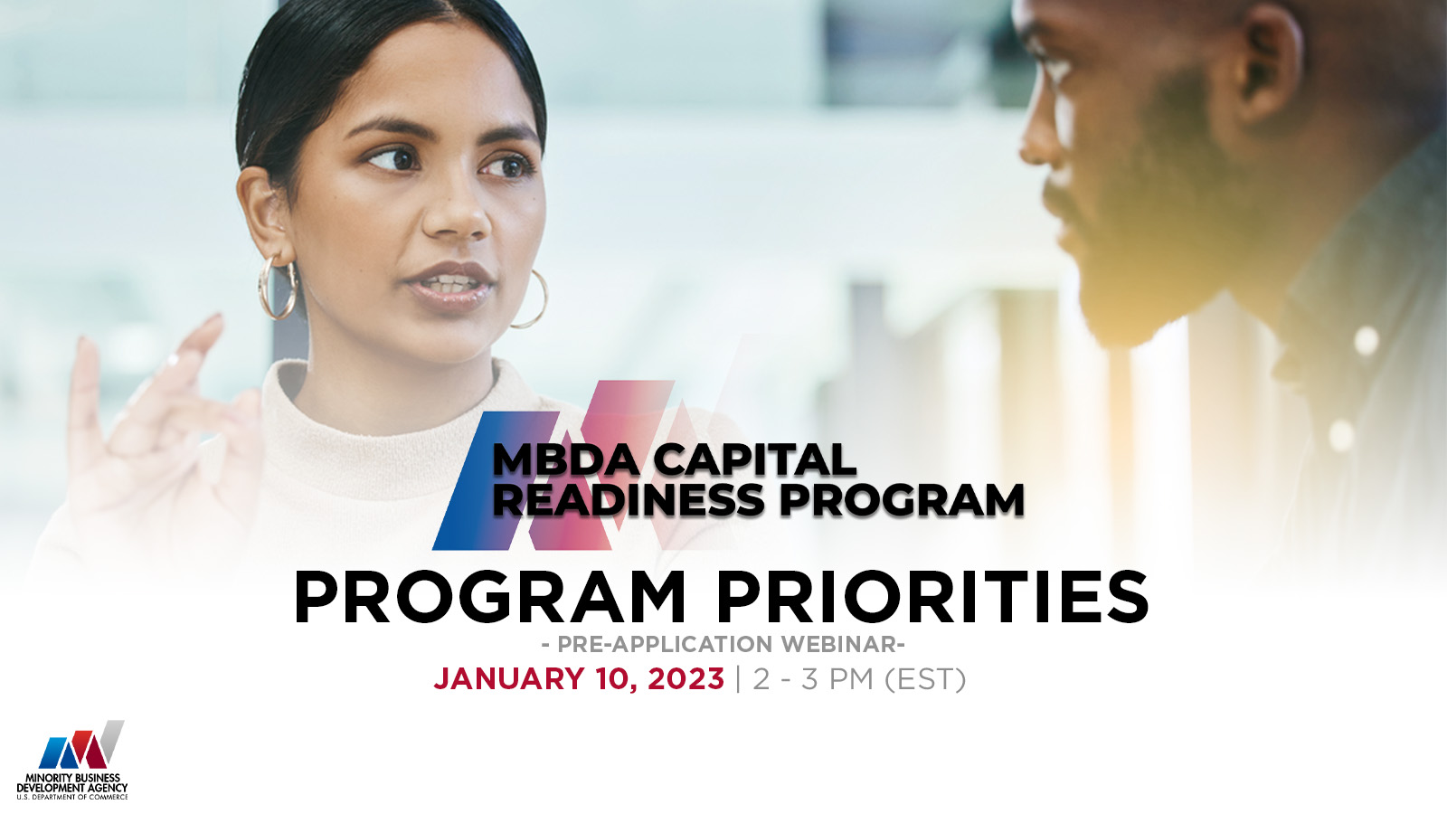
BUDGET BEST PRACTICES AND MEASURING PERFORMANCE
JANUARY 24, 2023
Notes:
Add “Pre-Application Webinar”

Slide 2
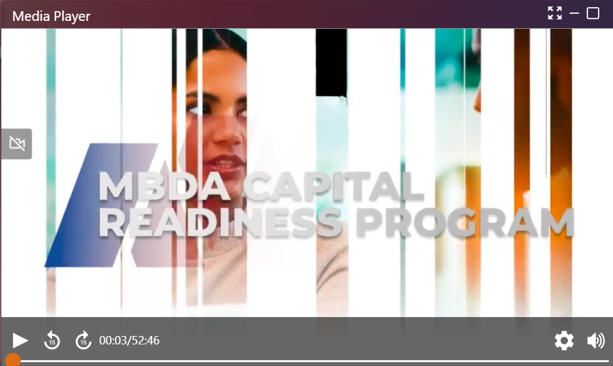
TECH TIPS FOR WEBINAR PLATFORM
IMPROVING VIDEO QUALITY
Webinars are bandwidth-intensive, close other applications/browsers that use bandwidth (e.g., Zoom, MS Teams, Webex, etc.)
ADJUSTING AUDIO
Control your volume, mute, and unmute from the lower right corner of the MEDIA PLAYER screen.

Slide 3
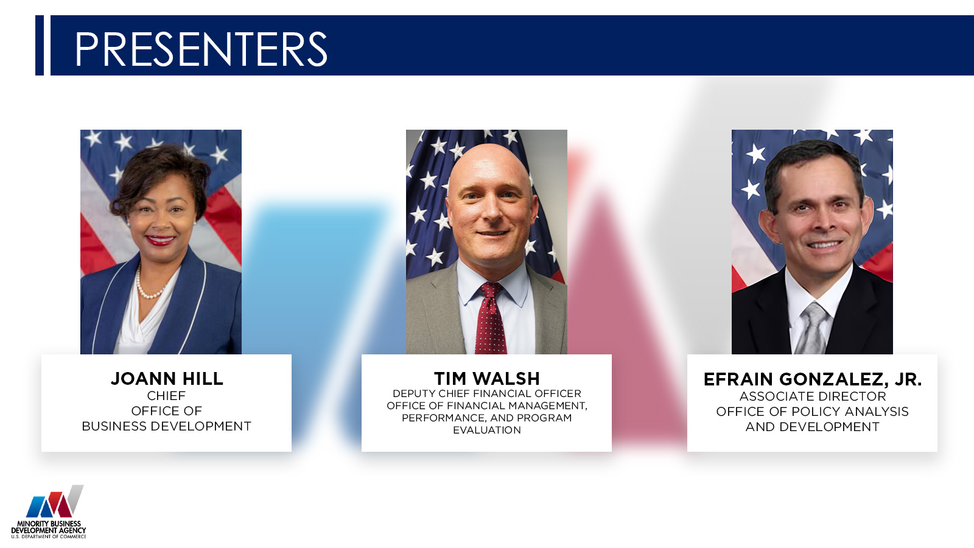
Notes:
JOANN

Slide 4
PRELIMINARY INFORMATION
This webinar is for informational purposes only and is intended solely to assist potential applicants in better understanding the MBDA Capital Readiness Program and the application requirements set forth in the Notice of Funding Opportunity (NOFO) for this program.
The information in this webinar does not and is not intended to supersede, modify, or otherwise alter applicable statutory or regulatory requirements or the specific application requirements set forth in the NOFO. In all cases, applicable statutory and regulatory mandates and the requirements set forth in the NOFO shall prevail over any inconsistencies presented in this Webinar.
Notes:
SANDI is this the latest content?
JOANN

Slide 5
PRELIMINARY INFORMATION
  This is a funding competition for technical assistance providers to provide services under the MBDA Capital Readiness Program
  This competition is not for individual entrepreneurs or small business owners to use the funds to grow their own businesses.
  If you are an entrepreneur or small business owner who needs help, please visit MBDA.gov to explore what current MBDA programs may fit your needs.
Notes:
SANDI is this the latest content?
JOANN

Slide 6
WEBINAR PROTOCOL
Submit all questions via the Q&A prompt.
Questions will be answered in writing throughout the webinar
We are in the process of updating the Frequently Asked Questions (FAQs) page with answers to additional questions
Keep questions relevant to the topic at hand
Notes:
EDIT for the Team: Plain language edit
JOANN

Slide 7
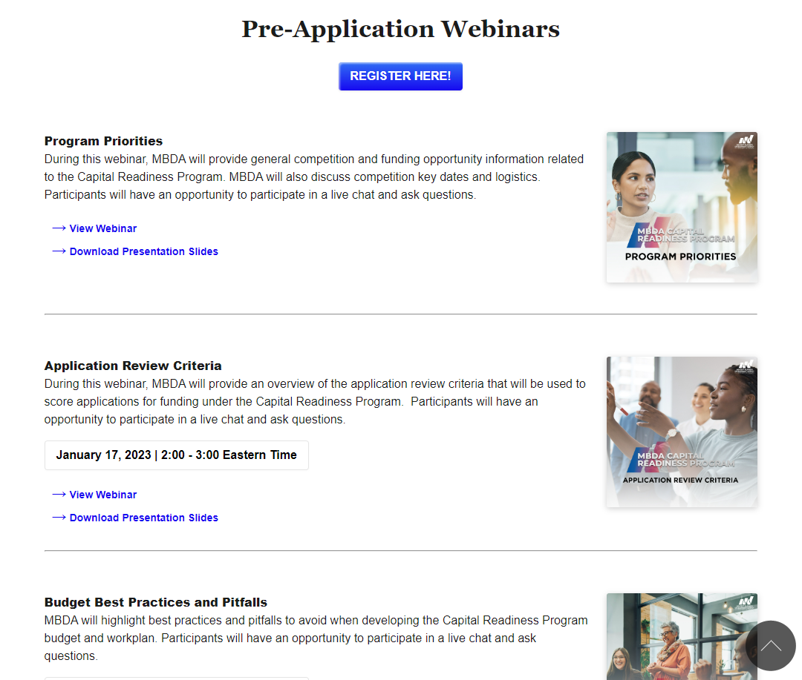
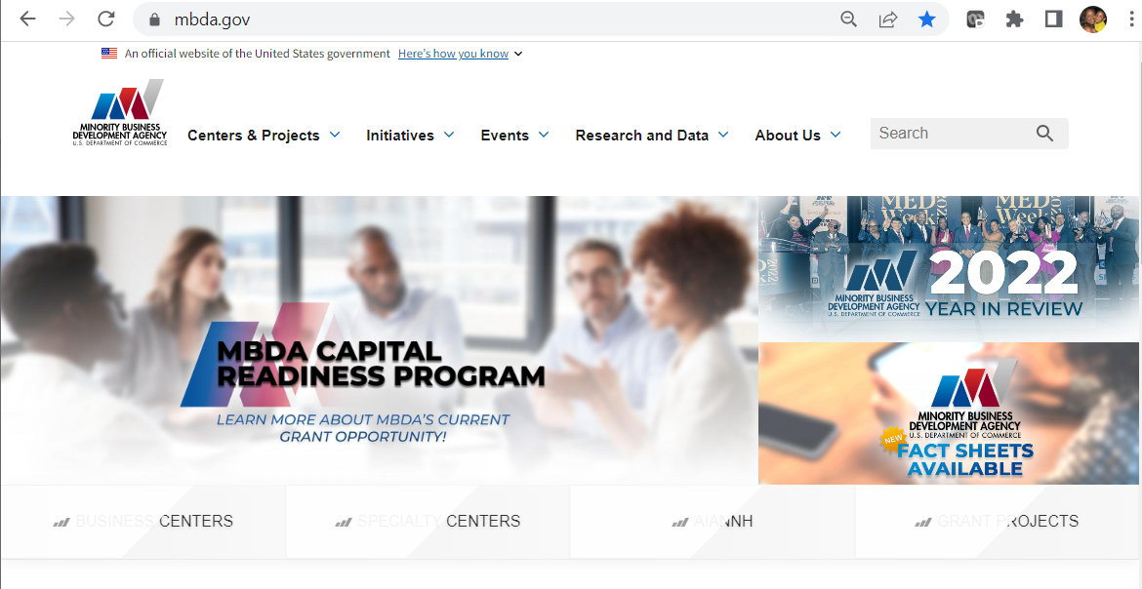
WEBINAR RECORDINGS
www.MBDA.gov

Slide 8

AGENDA
1. Capital Readiness Program (CRP) Overview
2. Notice of Funding Opportunity
3. Budget Best Practices
4. Tips and Common Mistakes to Avoid
5. Measuring Success and Performance
6. Questions and Answers
CAPITAL READINESS PROGRAM OVERVIEW
January 24, 2023
Notes:
New transition slide – titled Project Narrative Guidance

Slide 9
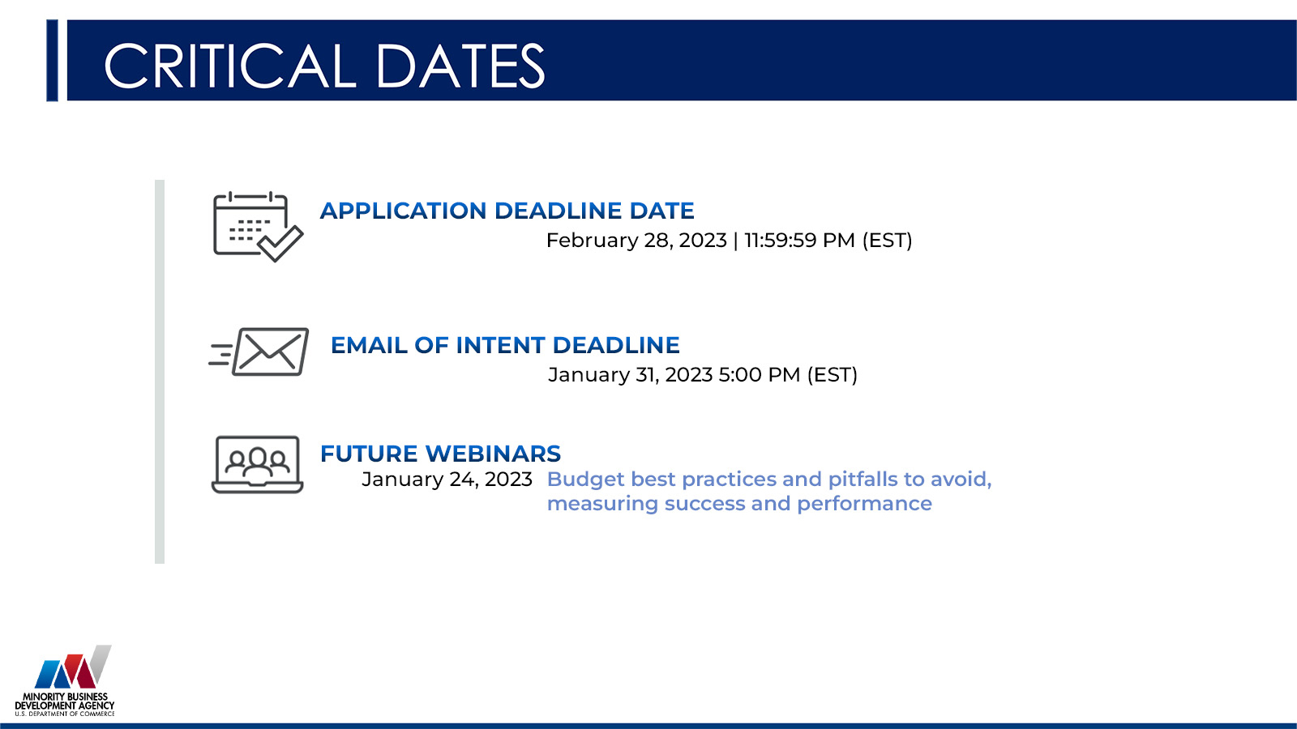
Notes:
JOANN

Slide 10

WHAT IS THE CAPITAL READINESS PROGRAM?
The MBDA Capital Readiness Program (Program) is designed to help close the entrepreneurship gap between socially and economically disadvantaged individuals (SEDI) and non-SEDI.
The Program seeks applications from qualified organizations that have the expertise to provide technical assistance for entrepreneurs starting or scaling their businesses who are seeking various forms of capital.
The competition seeks applicants that:
  help SEDI entrepreneurs build capacity;
  attract and provide access to capital opportunities; and
  attract and provide access to network
The services provided through MBDA’s Capital Readiness Program are intended to serve entrepreneurs and businesses that are applying to the Department of Treasury’s State Small Business Credit Initiative (SSBCI) or other government programs that support small businesses.
The Capital Readiness Program is funded by SSBCI, which provides $10 billion to states, territories, and Tribal Governments to promote entrepreneurship and increase access to capital.
Notes:
Note on updates to this page . . . BLUE BOX added with Treasury “call out”
JOANN

Slide 11
SERVICE MODELS
Proposals must demonstrate activities that resemble service models of incubators or accelerators or provide a combination of both.
Incubators
Accelerators
Early Stage
Emerging Stage
Helping startups and early-stage entrepreneurs launch their businesses, products, and services.
Helping emerging businesses that have moved beyond the earliest stages and need more sophisticated guidance and peer support to scale their business.
MBDA strongly encourages applicants to include technical assistance for new entrepreneurs and/or businesses in the early stages of the business lifecycle as part of its offerings.
EXAMPLES OF SERVICE MODEL ACTIVITIES
see NOFO page 9
Notes:
JOANN
NEW SLIDE FOR REVIEW . . . Incorporates “Service Models” content and NOFO reference
VDW’s Notes on Program Design (per NOFO document): The proposed activities may resemble the service models of incubators (focusing on early-stage technical assistance for new entrepreneurs) or accelerators (providing emerging-stage technical assistance to businesses ready to expand or scale) or provide a combination of both service models. Note: given the widespread need for support for early-stage services for entrepreneurs, MBDA encourages applicants to include services for new entrepreneurs and/or businesses in the early stages of the business lifecycle as part of its offerings.

Slide 12
ELIGIBLE APPLICANTS
Non-profit organizations;
Private sector entities (defined as entities that are not public sector entities);
  This includes, for example, for-profit entities of any type, including sole-proprietorships, partnerships, limited liability companies, and corporations; but
  Does not include public sector entities, such as Federal, State, Local, or Tribal Governments, agencies, or any of their instrumentalities;
Institutions of higher education; and
A consortium of two or more of any of the above-mentioned eligible applicants
  In a consortium application, there must be a designated lead applicant; and
  The lead applicant would assume primary operational and financial responsibility for the project.
IMPORTANT NOTE: MBDA is not authorized to provide cooperative agreements to individuals under this NOFO, and such requests will not be considered for funding.
Notes:
JOANN
SANDI TO REVIEW:
Yellow highlighted text for accuracy
How the text is “featured” in red box

Slide 13
AGENDA
1. Capital Readiness Program (CRP) Overview
2. Notice of Funding Opportunity
3. Budget Best Practices
4. Tips and Common Mistakes to Avoid
5. Measuring Success and Performance
6. Questions and Answers
NOTICE OF FUNDING OPPORTUNITY
January 24, 2023
Notes:
New transition slide – titled Project Narrative Guidance

Slide 14
WHAT IS A NOFO?
A Notice of Funding Opportunity (NOFO):
Announces the grant opportunity
Contains details about the application requirements and procedures to request Federal funding for eligible projects
Contains the budget requirements and performance metrics requirements that we're here to talk about today
Notes:
JOANN

Slide 15
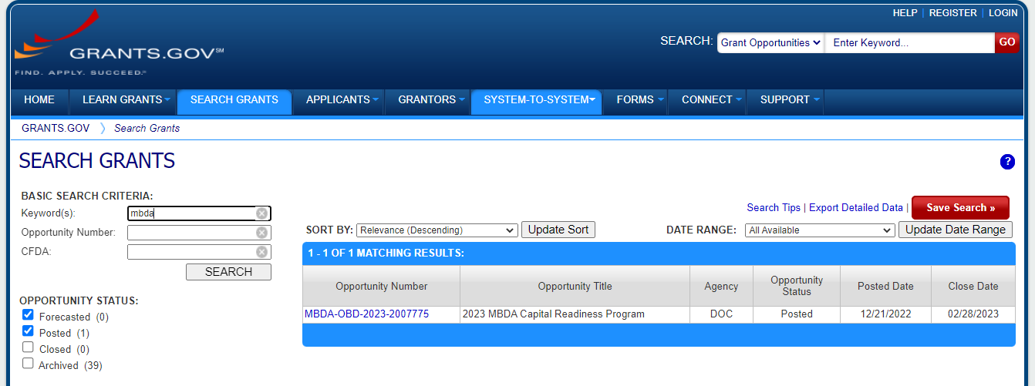
WHERE DO I FIND THE NOFO?
Click on the links on the MBDA website or search “mbda” on GRANTS.GOV:
Click the Opportunity Number
to see the Synopsis and the full NOFO text (under “Related Documents” tab)
Notes:
JOANN
Update once the NOFO is posted.

Slide 16

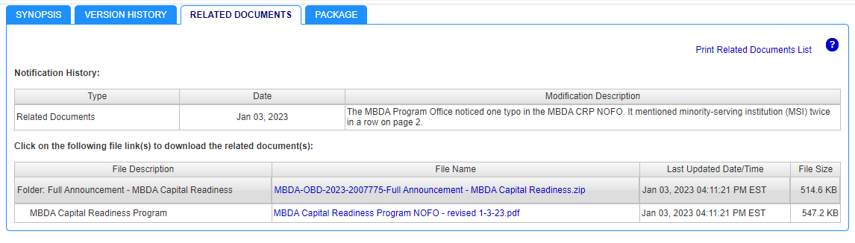
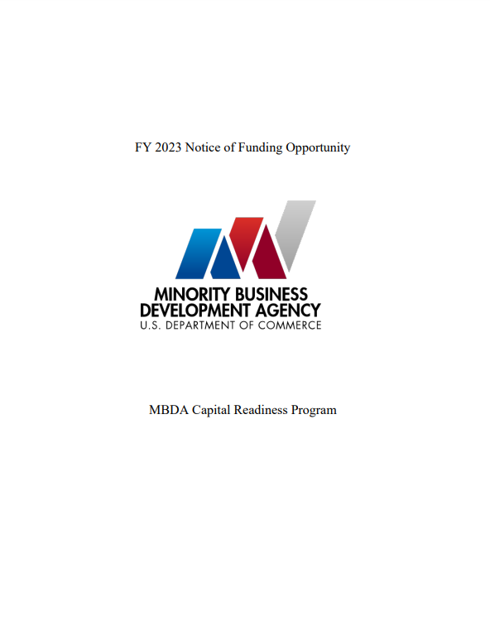
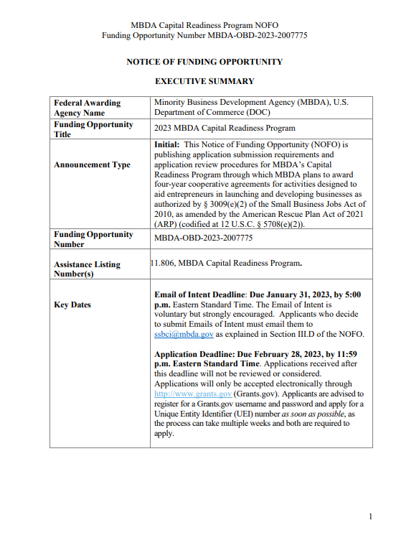
THE NOFO
Notes:
JOANN
EDIT to Team: Title Check

Slide 17
AGENDA
1. Capital Readiness Program (CRP) Overview
2. Notice of Funding Opportunity
3. Budget Best Practices
4. Tips and Common Mistakes to Avoid
5. Measuring Success and Performance
6. Questions and Answers
BUDGET BEST PRACTICES
January 24, 2023
Notes:
New transition slide – titled Project Narrative Guidance

Slide 18
WHAT IS THE AVAILABLE FUNDING?
Available grant funding: $93.5 million
Number of anticipated awards: 35-46
Performance period: 4 years (2023 – 2027)
Awardees will get access to funds each year. Funding will be disbursed to each recipient contingent upon recipient’s performance, including securing the required matching funds.

Slide 19
HOW MUCH FUNDING CAN I REQUEST?
The MAXIMUM amount of funding any application can request is $750,000 per year for 4 years for a total of $3,000,000
There is no minimum required yearly budget for your proposed project. However, recall that MBDA seeks to fund holistic projects, not one-off services. MBDA encourages applicants to consider proposing activities that justify a yearly budget of $500,000-750,000 for four years
Tier Level | Yearly Budget Amount | Required Non-Federal Share | Estimated Total Federal Funding (Over Four Years)
Tier 1 | Up to $500,000 | 10% | Up to $2,000,000
Tier 2 | From $500,001 to $625,000 | 15% | From $2,000,001 to $2,500,000
Tier 3 | From $625,001 to $750,000 | 25% | From $2,500,001 to $3,000,000
Notes:
COMPLETED: GRAPH NEEDS TO BE RECREATED

Slide 20
NON-FEDERAL COST SHARE REQUIREMENTS
Non-federal match ranging from 10% to 25% depending on the award amount
Reference Sections II.A and III.B of the NOFO for important rules governing non-federal cost share/matching requirement
Please also review carefully 2 C.F.R. 200.306
Tier Level | Yearly Budget Amount | Required Non-Federal Share | Estimated Total Federal Funding (Over Four Years) | Estimated Total Non-Federal Share (Over Four Years)
Tier 1 | Up to $500,000 | 10% | Up to $2,000,000 | Up to $200,000
Tier 2 | From $500,001 to $625,000 | 15% | From $2,000,001 to $2,500,000 | From $300,001 to $375,000
Tier 3 | From $625,001 to $750,000 | 25% | From $2,500,001 to $3,000,000 | From $625,001 to $750,000
Notes:
COMPLETED: GRAPH NEEDS TO BE RECREATED

Slide 21
NON-FEDERAL COST SHARE BASICS
Non-federal cost share can be from cash (including through project revenue) or in-kind sources. MBDA has no preference as to the source of the non-federal match share so long as it complies with 2 C.F.R. 200.306.
  If you plan to use funds you have received from other Federal financial assistance programs to meet the match, you must ensure that those programs allow funding to be used for cost sharing purposes.
  2 C.F.R. 200.306 gives important information about how to value property and services included in the non-federal match (see also 2 C.F.R. 200 Appendix E)
  Volunteer services furnished by third-party professional and technical personnel, consultants, and other skilled and unskilled labor may be counted as cost sharing or matching if the service is an integral and necessary part of an approved project or program. See 2 C.F.R. 200.306 for more information.
Notes:
COMPLETED: GRAPH NEEDS TO BE RECREATED

Slide 22
MATCHING SHARE COMMITMENT
At the time of application, applicants must indicate their commitment to the non-federal cost share and submit a plan that demonstrates their ability to meet the required matching share over the course of the four-year program.
This plan includes identifying all sources of funds, including but not limited to: current assets, prospective income streams (including but limited to program fees), third-party contributions (either cash or in-kind), etc.
Note: If an applicant has requested a waiver, the applicant must also submit a plan to meet the matching share if they wish to be considered for funding in the event that waiver is not granted.
As a condition of continued funding, awardees may be required to submit updated plans, commitment letters, or other documentation for matching share funds in future budget years. Failure to meet the required the non-federal cost match may result in termination of the award.
Notes:
COMPLETED: GRAPH NEEDS TO BE RECREATED

Slide 23
CALCULATING ANNUAL BUDGET
Remember – when proposing your budget, you must capture the MBDA funding you receive plus the yearly non-federal share amount, based on your funding tier
In other words:
  Total annual budget equals annual Federal funding requested plus the required non-Federal share.
For example – If the applicant requests $500,000 per year in MBDA funding, then the total yearly budget for all budget documents is that $500,000 plus 10% (Tier 1):
$500,000 + $50,000 = $550,000 per year
Remember to break out your costs by federal and non-federal shares in your
budget documents.
Notes:
COMPLETED: GRAPH NEEDS TO BE RECREATED

Slide 24
PROJECT AWARD PERIOD
Subject to availability of funding, MBDA expects to issue awards for a total term of four years from July 1, 2023 – June 30, 2027. The initial budget year will be 12 months. Subsequent budget years will be for 12-month terms, as outlined below.
Year | Fiscal Year | Months | Anticipated Budget Year
Year 1 | FY23 | 12 months | July 1, 2023 | June 30, 2024
Year 2 | FY24 | 12 months | July 1, 2024 | June 30, 2025
Year 3 | FY25 | 12 months | July 1, 2025 | June 30, 2026
Year 4 | FY26 | 12 months | July 1, 2026 | June 30, 2027
Notes:
COMPLETED: GRAPH NEEDS TO BE RECREATED

Slide 25
WHAT IS THE FUNDING INSTRUMENT?
Funding will be made through a cooperative agreement. After the award is made, MBDA will be substantially involved in the activities of this Program, including but not limited to:
Providing training relating to the purpose of this Program, eligible activities, and program performance goals.
Requiring recipients to participate in a pre-implementation conference with MBDA to review the proposed technical assistance, services, and performance goals that the recipient will provide and measure.
Providing necessary guidance and facilitating collaborations with other MBDA programs and initiatives, jurisdictions receiving SSBCI funds from the U.S. Department of Treasury, and Federal agencies other than MBDA, as appropriate.
Monitoring activities carried out by the awardee, including by soliciting feedback from enrolled SEDI businesses.
Conducting periodic Program evaluation and providing findings for improvement.
Establishing and enforcing administrative, communications, and reporting requirements for each awardee.
Providing access to and training for a performance management reporting system.

Slide 26
WHAT BUDGET FORMS ARE REQUIRED?
Standard Forms
  SF-424 (Application for Federal Assistance)
    Note: submit only one SF-424 that covers all four years.
  SF-424A (Budget Information Non-Construction Programs)
    Note: submit a separate SF-424A for each budget year (total of 4 SF-424As)
  SF-424B (Assurances for Non-Construction Programs)
Budget Narrative
  Note: submit only one budget narrative that covers all four years.
  Indirect Cost Rate (ICR) Agreement Documentation (if applicable)

Slide 27
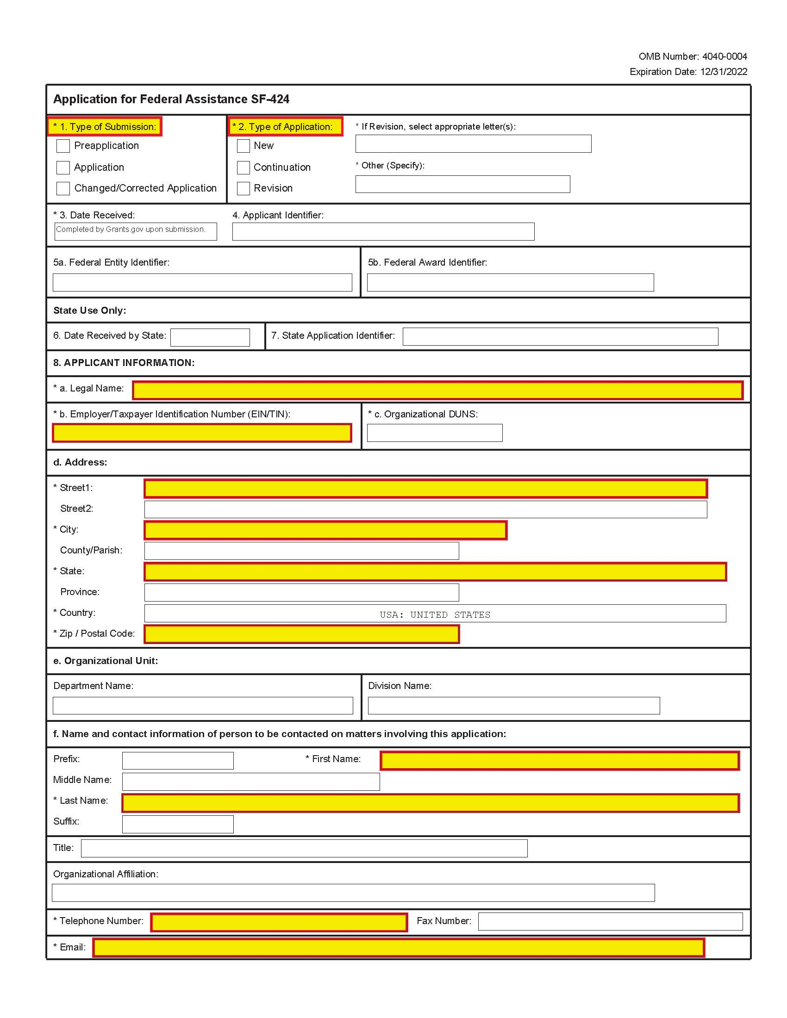
SF-424 (page 1 of 3)

Slide 28
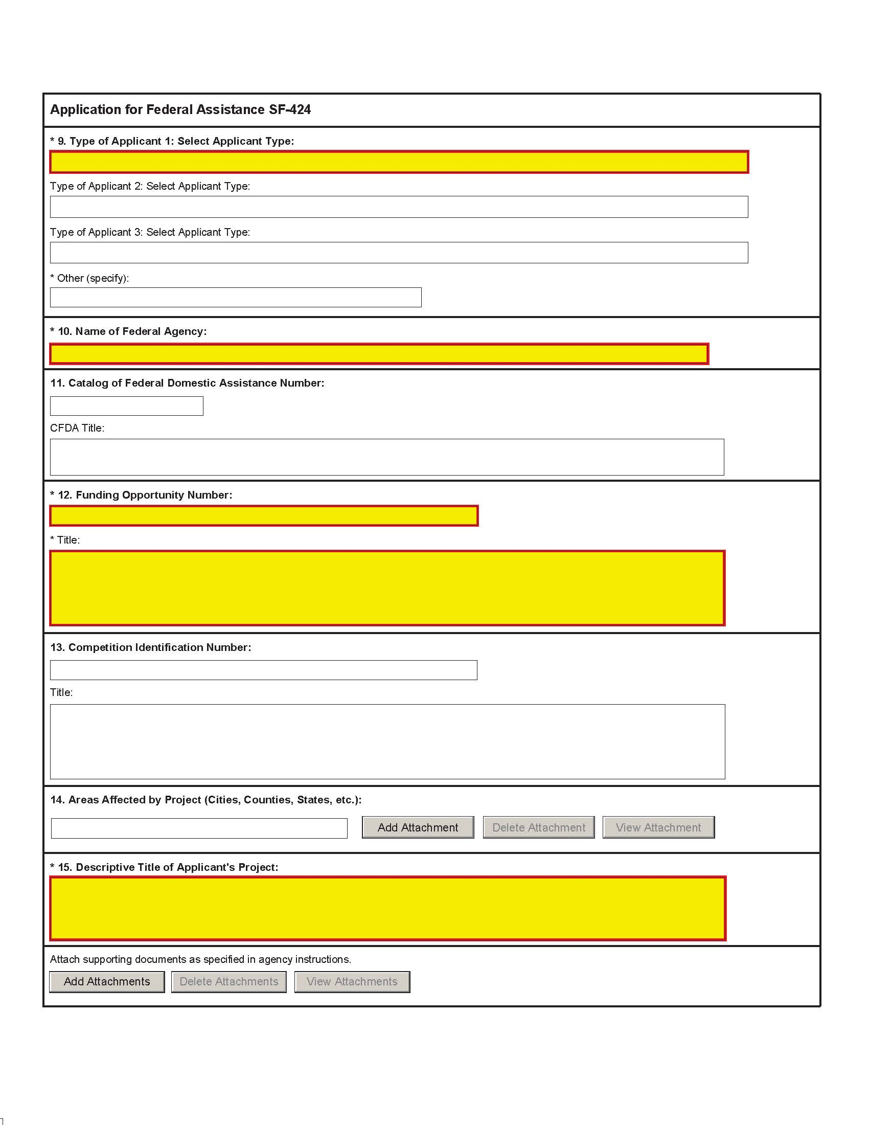
SF-424 (page 2 of 3)

Slide 29
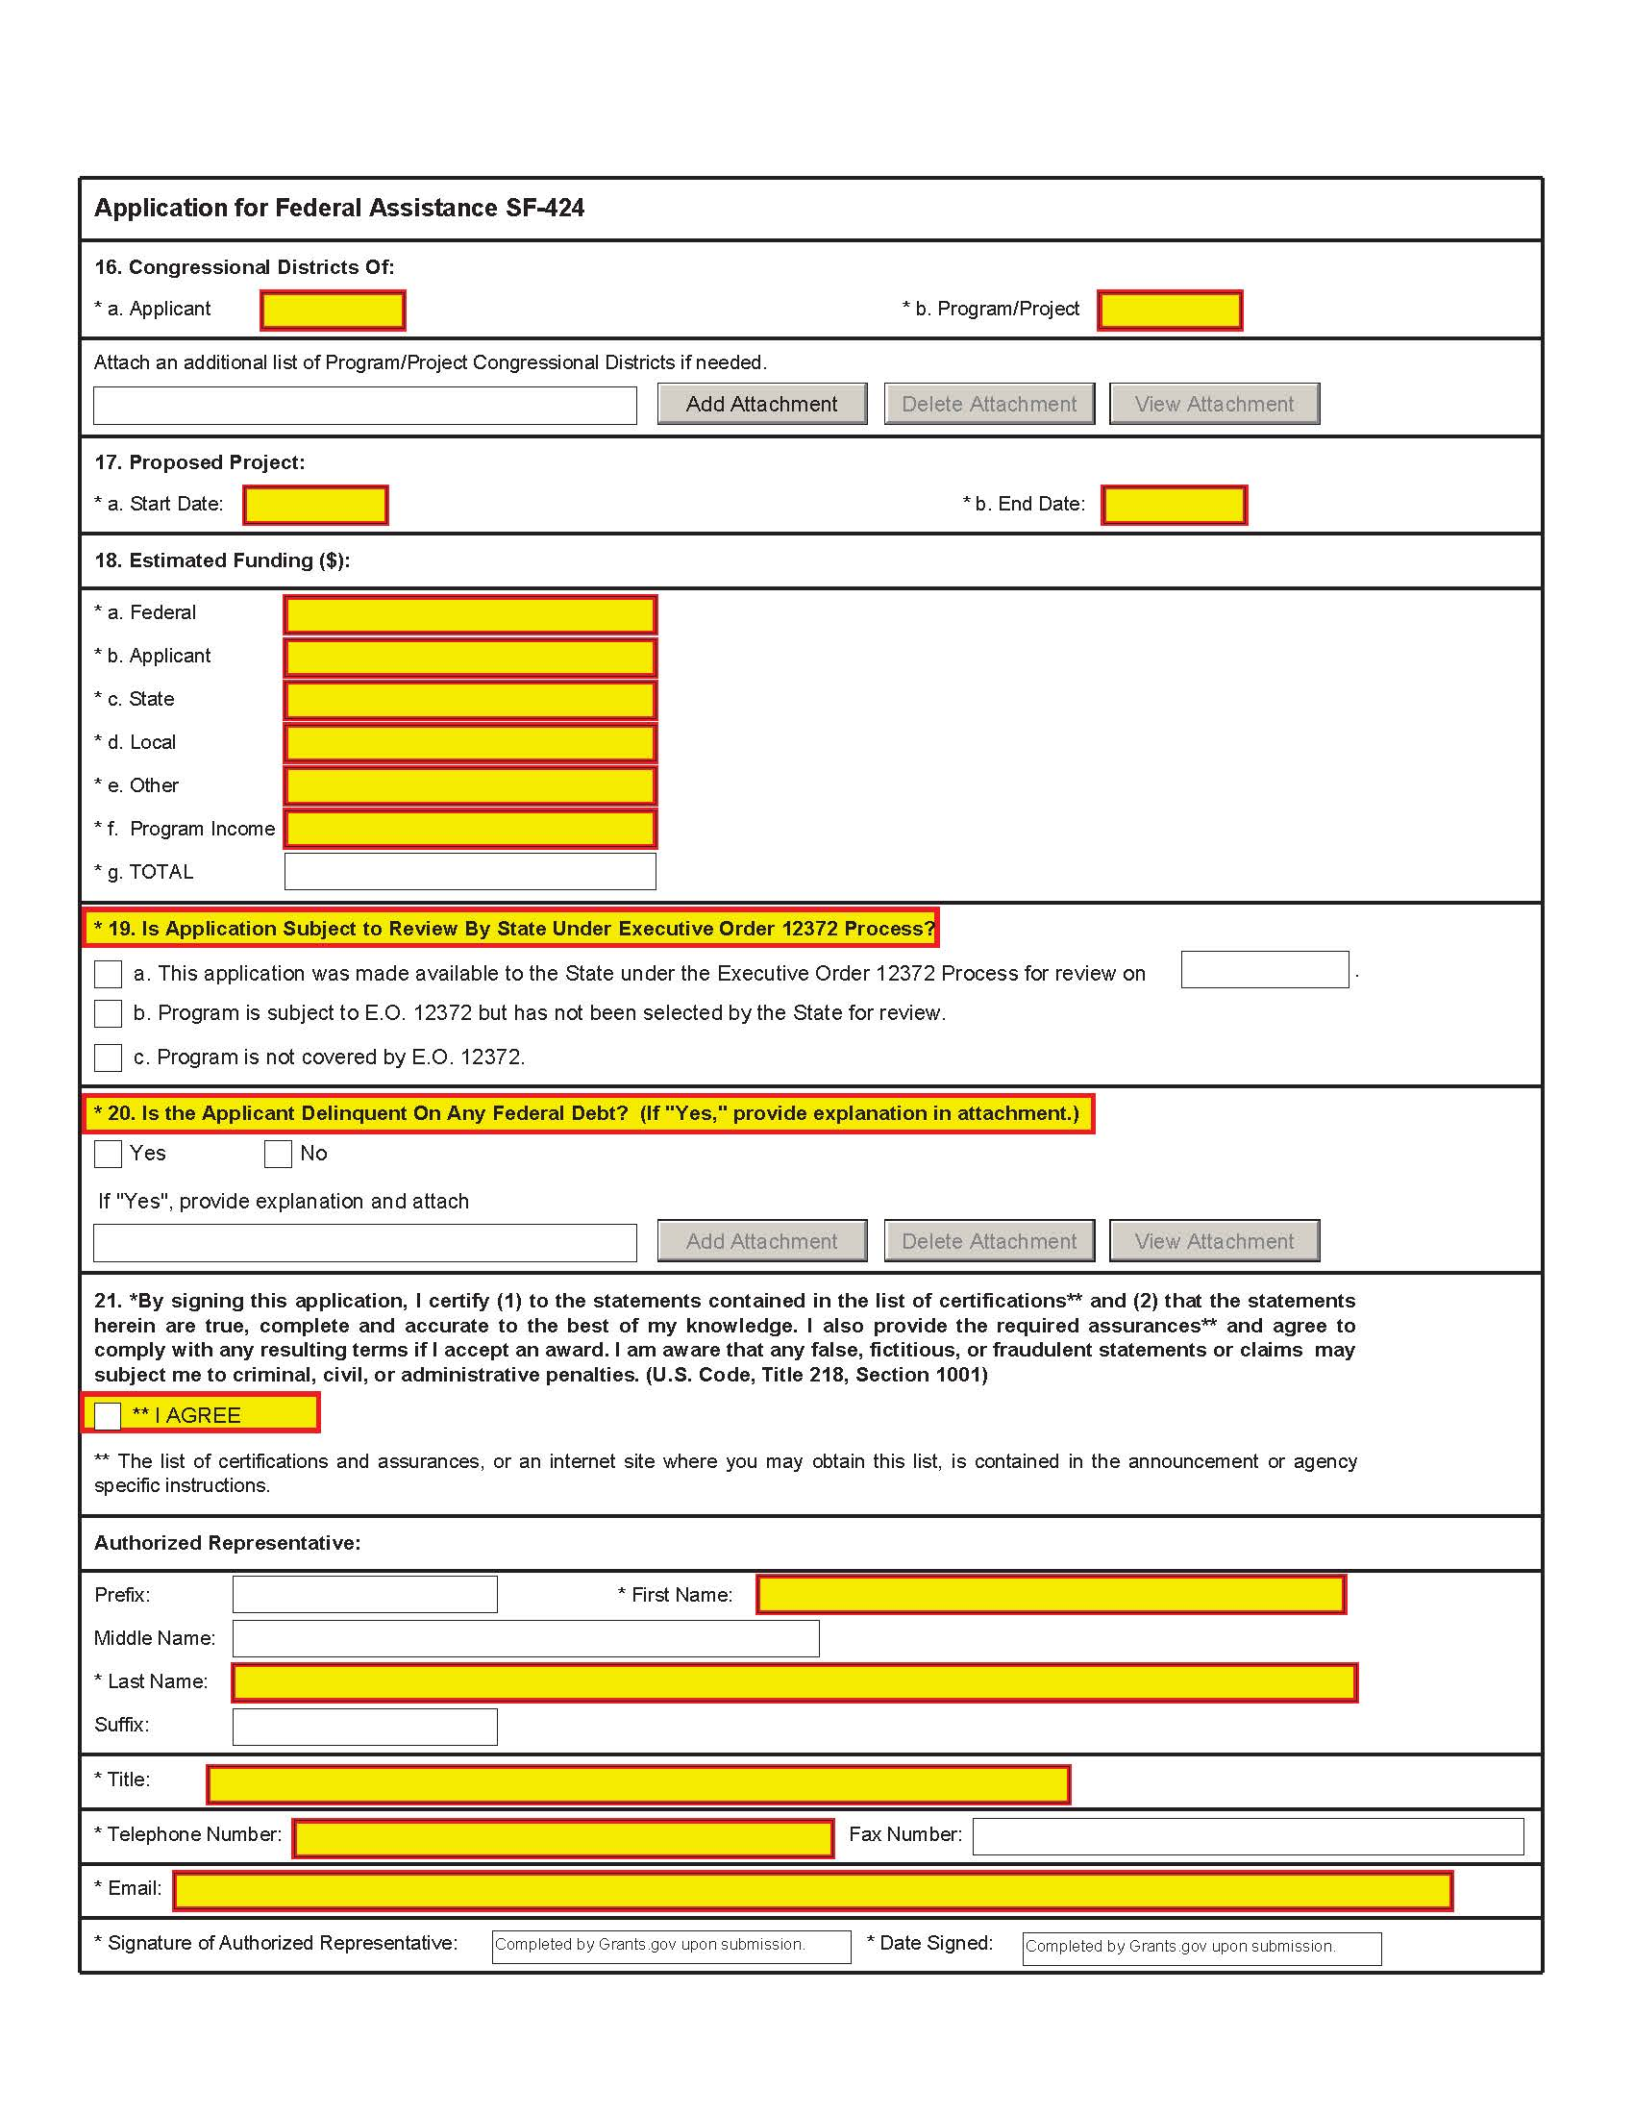
SF-424 (page 3 of 3)

Slide 30
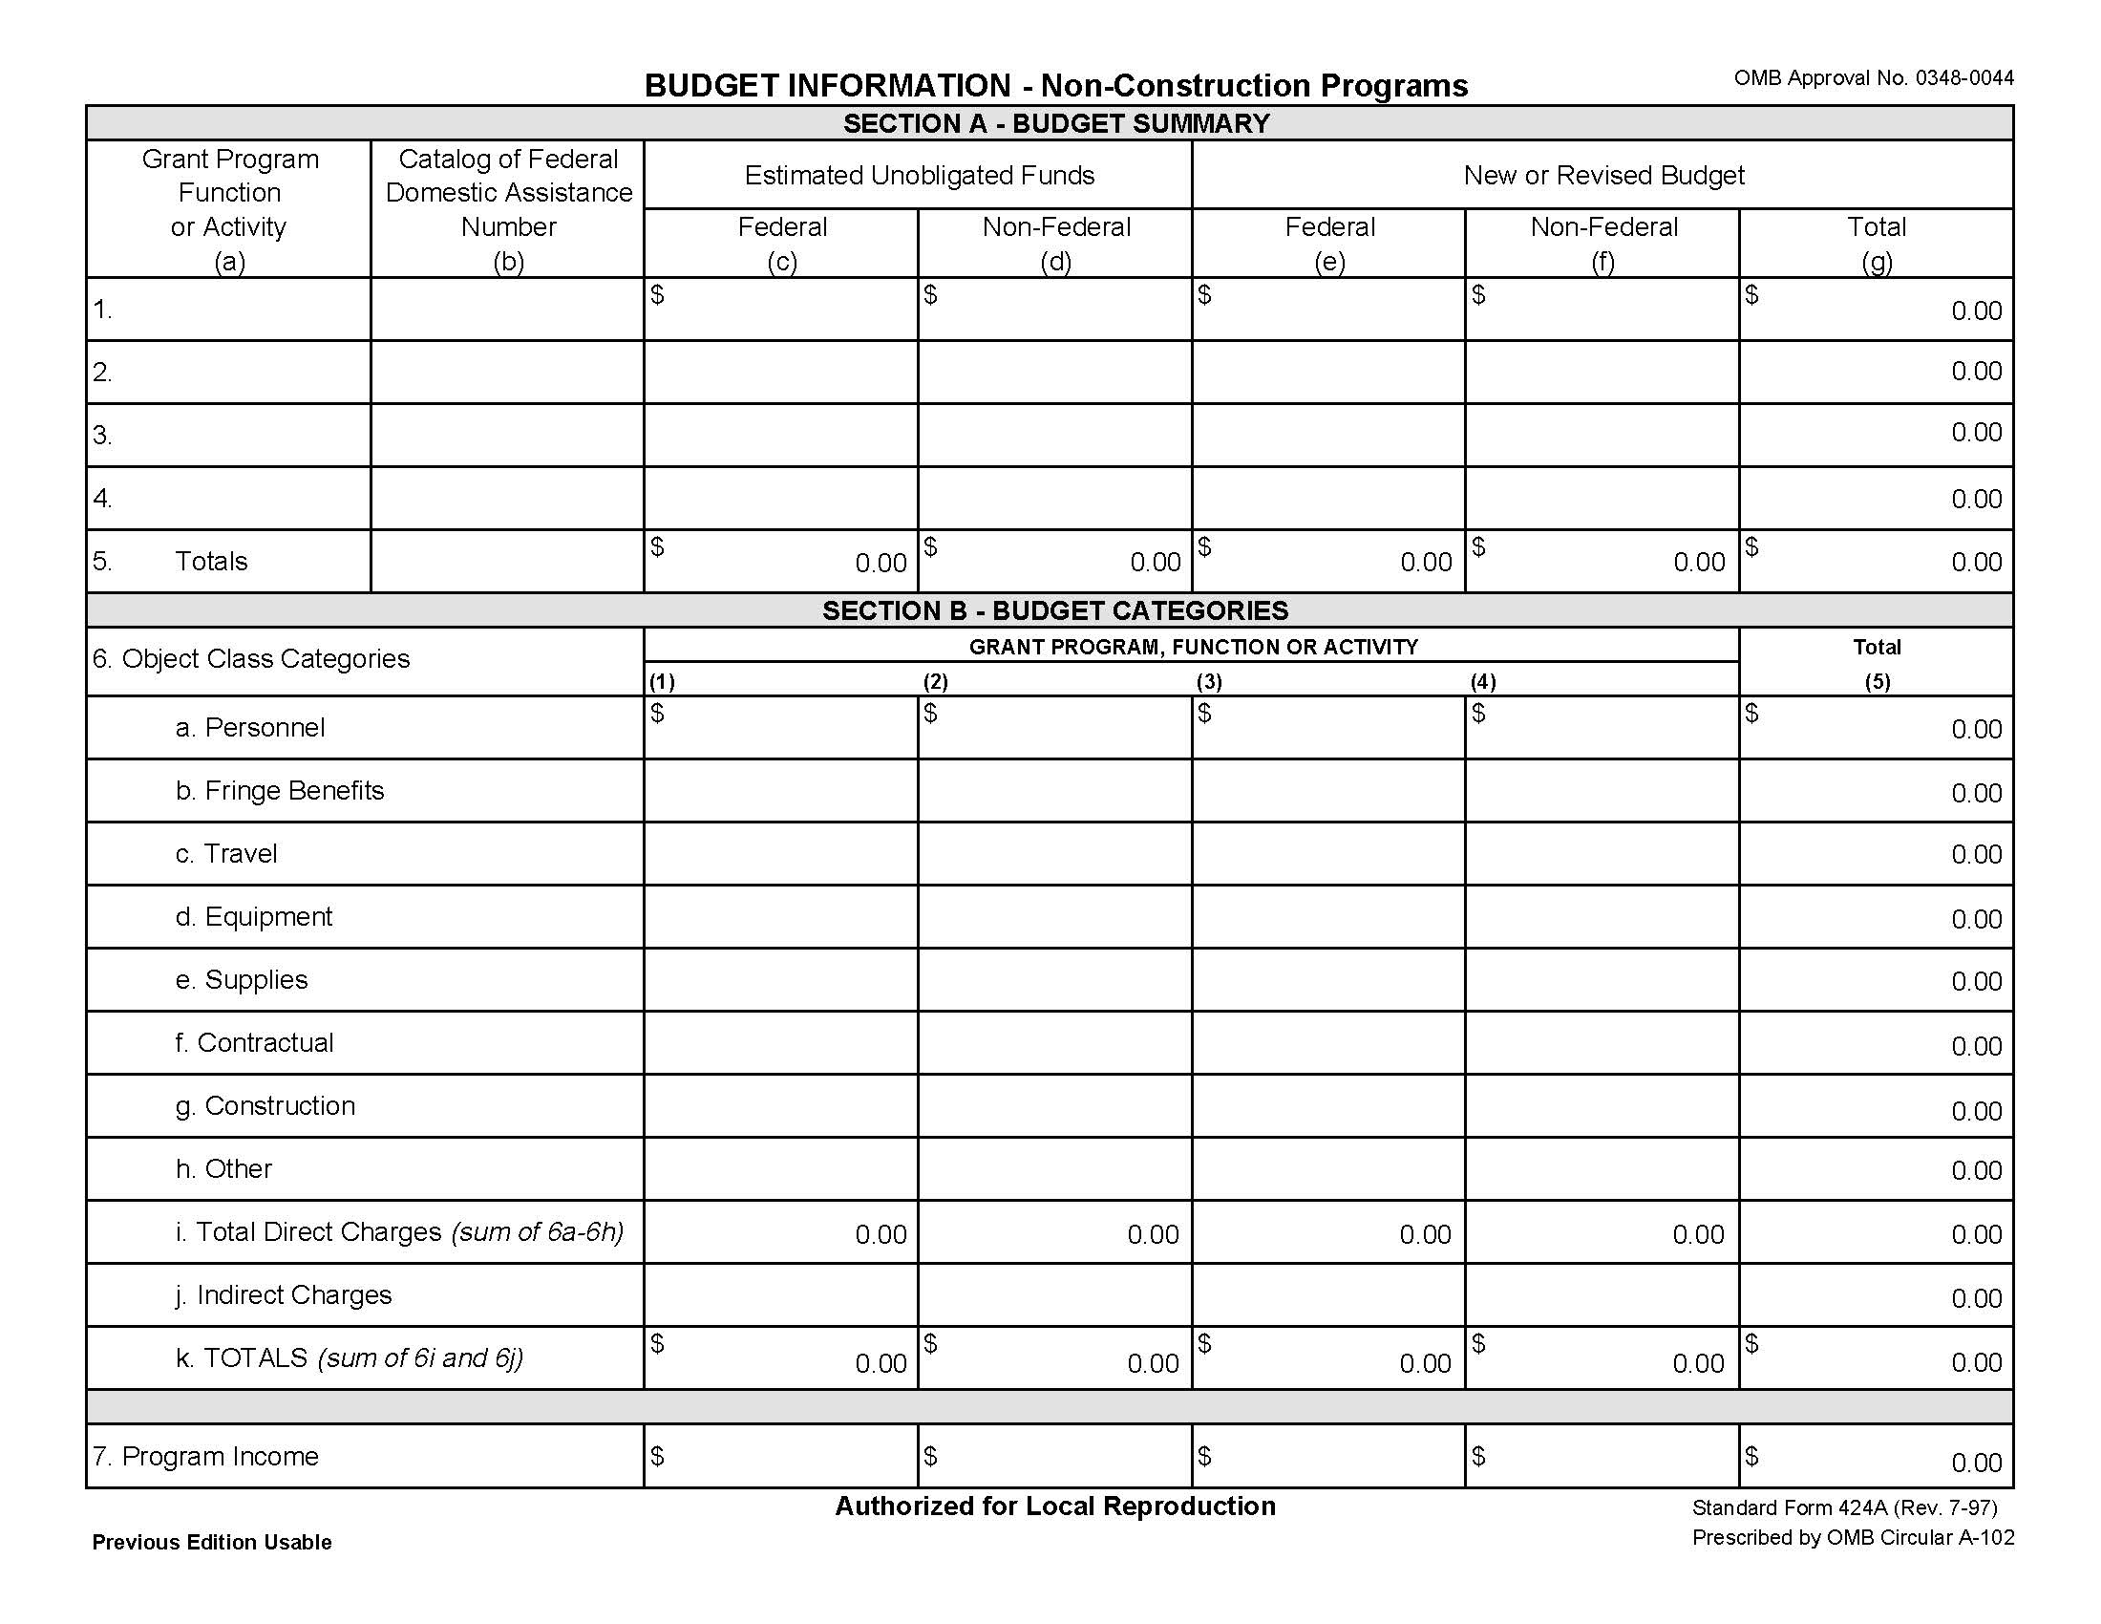
SF-424A (page 1 of 2)

Slide 31
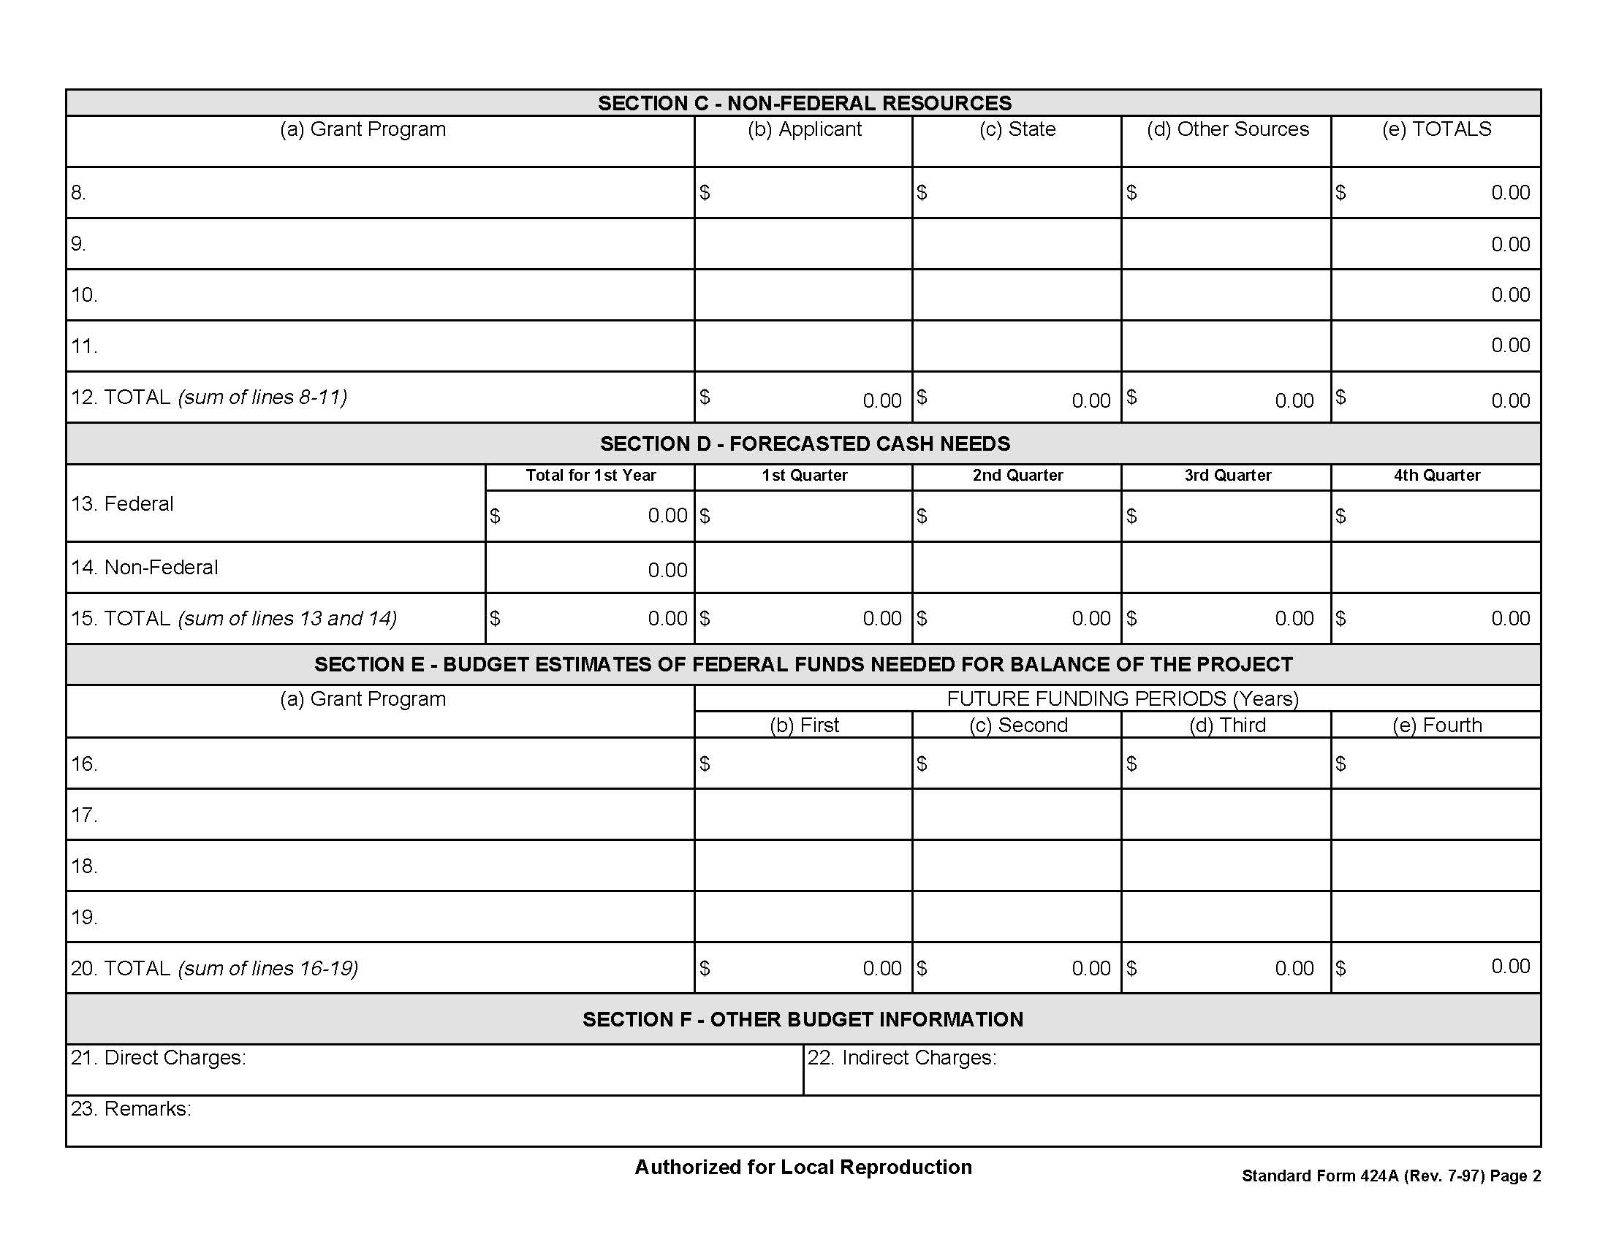
SF-424A (page 2 of 2)

Slide 32
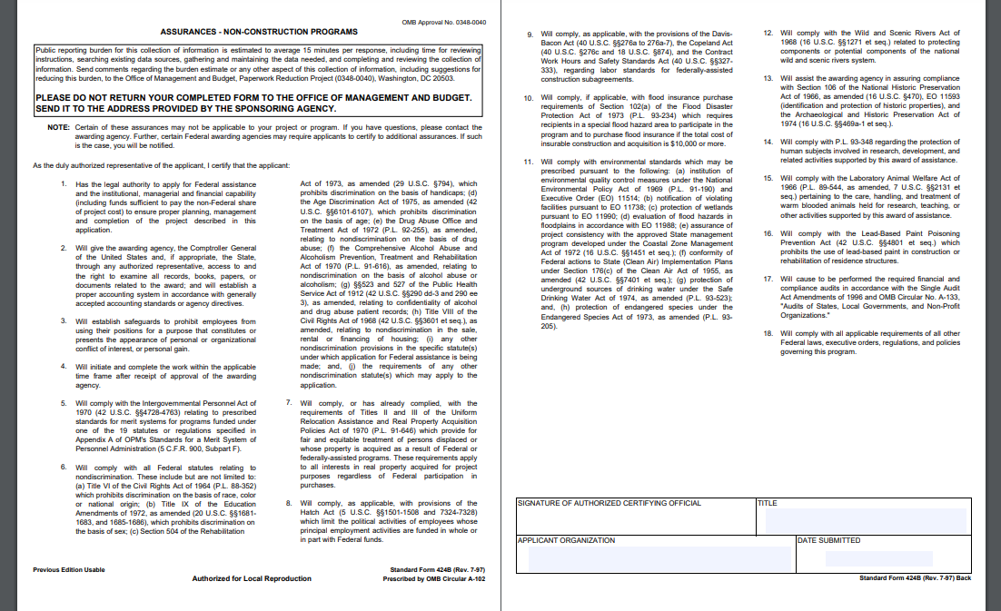
SF-424B

Slide 33
BUDGET NARRATIVE
Applicants MUST provide a clear budget narrative that identifies and justifies how funds in each line item of the budget (e.g., staffing, work activities, materials and supplies, outreach, equipment, etc.) will be used to support the proposed project.
  Keep in mind: This is one of the most important documents in your application. Show us how you carefully thought through your proposed costs and activities. Show us that you have a plan to support your project through the 4-year performance period.
The budget narrative should specifically address each budget line item (including both the Federal and matching non-Federal share).
The budget narrative total should match exactly the total project costs listed in both the SF-424, Question 18, Line g (“TOTAL”) and the appropriate Federal and non-Federal total fields of the SF-424A.

Slide 34
KEY CONCEPTS FOR DEVELOPING BUDGET
When developing your project’s proposed budget, you should always keep in mind whether a proposed cost is:
ALLOWABLE – is the cost permitted under the law and the terms of this Program? See 2 C.F.R. 200.403 for more information.
  Keep in mind: is the cost prohibited under the terms of this NOFO?
    Examples of prohibited costs: paying for childcare services with program funds (NOFO page 31), equity investments and direct loans to entrepreneurs (NOFO page 26)
REASONABLE – is the nature and amount of the proposed cost reasonable?
  Keep in mind: would a reasonable person incur the cost in the same circumstances, after appropriate market research? See 2 C.F.R. 200.404 for more information.
ALLOCABLE – is the cost for the benefit of this Program?
  Keep in mind: there is a three-part test in 2 C.F.R. 200.405. Review that standard carefully.

Slide 35
REQUIRED COST - TRAVEL LINE ITEMS
  Required Travel
    4-day trip for two staff persons (one of whom must be the project director) to attend MBDA’s National Capital Readiness Program Implementation Meeting in Washington, DC, during the first year of the program.
    Budget for two additional trips for each year of the program for up to two staff persons (one of whom must be the project director):
      MBDA’s Minority Enterprise Development (MED) Week, and
      MBDA’s National Training Conference.
    Travel expenses for all required travel items should include transportation, lodging, and per diem and must align with the current Federal travel guidelines, found at https://www.gsa.gov/policy-regulations/regulations/federal-travel-regulation
    Applicants should plan for each trip to be 4 days. The location of the events may vary. To estimate costs, please use, DC as the location. Applicants may also budget for a program participant (SEDI entrepreneur) to travel to MED Week each year, subject to MBDA input and approval.

Slide 36
AGENDA
1. Capital Readiness Program (CRP) Overview
2. Notice of Funding Opportunity
3. Budget Best Practices
4. Tips and Common Mistakes to Avoid
5. Measuring Success and Performance
6. Questions and Answers
TIPS AND COMMON MISTAKES TO AVOID
January 24, 2023
Notes:
New transition slide – titled Project Narrative Guidance

Slide 37
TIPS
Begin the SAM registration process immediately.
Give yourself 5 or more days for application submission.
Ensure budget figures are accurate.
Providing necessary guidance and facilitating collaborations with other MBDA programs and initiatives, jurisdictions receiving SSBCI funds from the U.S. Department of Treasury, and Federal agencies other than MBDA, as appropriate.
Ensure the budget includes estimated travel, tax rates, social security, etc
Ensure the budget includes staffing expenses
Ensure the budget includes conferences and client visits
Ensure the submission includes the appropriate years for all standard forms
Ensure the budget narrative includes all four years
Comprehensively address all expenses that are required to operate effectively

Slide 38

MEASURING SUCCESS AND PERFORMANCE
Notes:
TIM

Slide 39
GOALS AND PERFORMANCE MEASURES
Applicants must propose specific numerical goals in their applications for each performance measure for each year of the project. See Appendix B of the NOFO. Applicants should also identify the rationale for the proposed measure, including any key assumptions underlying the measure (see NOFO page 18). The performance measures should be ambitious, realistic, achievable and reasonable given the amount of funding requested by the proposal.
The six (6) required measures (plus one additional) are as follows:
Number of SEDI entrepreneurs enrolled in the project
Number of SEDI entrepreneurs that graduate from the project
Number of networking events held
Number of SEDI entrepreneur or SEDI-owned business pitches to Capital provider(s)
Number of SEDI-owned businesses formed or scaled
Total amount of Capital raised (equity investments, debt, grants)
At least one additional performance measure to be defined by the applicant to best reflect project scope of work.

Slide 40
PERFORMANCE METRICS TIPS: THE PROGRAM LOGIC MODEL
Problem: The issue being addressed by the intervention/program
Goal(s): The intended aims or impacts over the life of the intervention/program
Resources
Activities
Outputs
The resources dedicated to or consumed by the program
The actions that the program takes to achieve desired outcomes
Outcomes
The tangible, direct products of the program’s activities
The expected changes among clients, communities, systems or organizations as a result of the program
Rationale & Assumptions: What are the underlying assumptions and rationale around the intervention and how it works?
External Factors: What else might affect the program?
40

Slide 41
PERFORMANCE MEASURES 1-4
Required Measure | Definition | Annual Goal
Number of SEDI entrepreneurs enrolled in the project | Number of SEDI entrepreneurs enrolled in the awardee’s project during the budget period. | Annual Goal Established by Applicant and approved by MBDA
Number of SEDI entrepreneurs that graduate from the project | Number of SEDI entrepreneurs who are complete project’s curriculum or module(s). | Annual Goal Established by Applicant and approved by MBDA
Number of networking events held | Number of networking events held includes formal networking events and other events that facilitate the formation of professional relationships, such as formal mentorships, peer support, advisory services with particular subject matter expertise, teaming arrangements, and service providers. | Annual Goal Established by Applicant and approved by MBDA
Number of SEDI entrepreneur or SEDI-owned business pitches to Capital provider(s) | Number of pitches made by SEDI entrepreneurs or SEDI-owned businesses to Capital providers that are made during the budget period. | Annual Goal Established by Applicant and approved by MBDA

Slide 42
PERFORMANCE MEASURES 5-7
Required Measure | Definition | Annual Goal
Number of SEDI-owned businesses formed or scaled | Number of businesses formed includes a new company that is formed to provide a product or service. Number of companies scaled includes, but is not limited to, companies that increase their capacity to produce more products, serve more clients, expand services, increase revenues, increase profits, create more jobs, or launch a significant new product or service. Awardees will be required to break down their reports further by each sub-category, | Annual Goal Established and approved by MBDA
Total amount of Capital raised (equity investments, debt, grants) | Total dollar value of Capital raised by SEDI entrepreneurs or SEDI-owned businesses as a direct result of assistance received by the project during the budget period Awardees will be required to break down their reports by line item (equity investments, debt, and grants) and source of Capital (such as SSBCI or other public or private source). | Annual Goal Established by Applicant and approved by MBDA
Other Performance Measure (at least one) | Defined by applicant to best reflect project scope of work | Annual Goal Established by Applicant and approved by MBDA

Slide 43
TIPS
Measures should be built from an evidence-based approach. See NOFO page 18 and NOFO Appendix B.
Identify the rationale for the proposed goals, including any key assumptions underlying the goals. See NOFO Appendix B.
Be mindful that there will be calls for reporting on these measures.
Utilize your expertise and knowledge of the communities you serve to set your outcome numbers.
Propose specific numerical goals in your applications for each performance measure for each year of the project.

Slide 44
CLOSING
Notes:
TIM

Slide 45
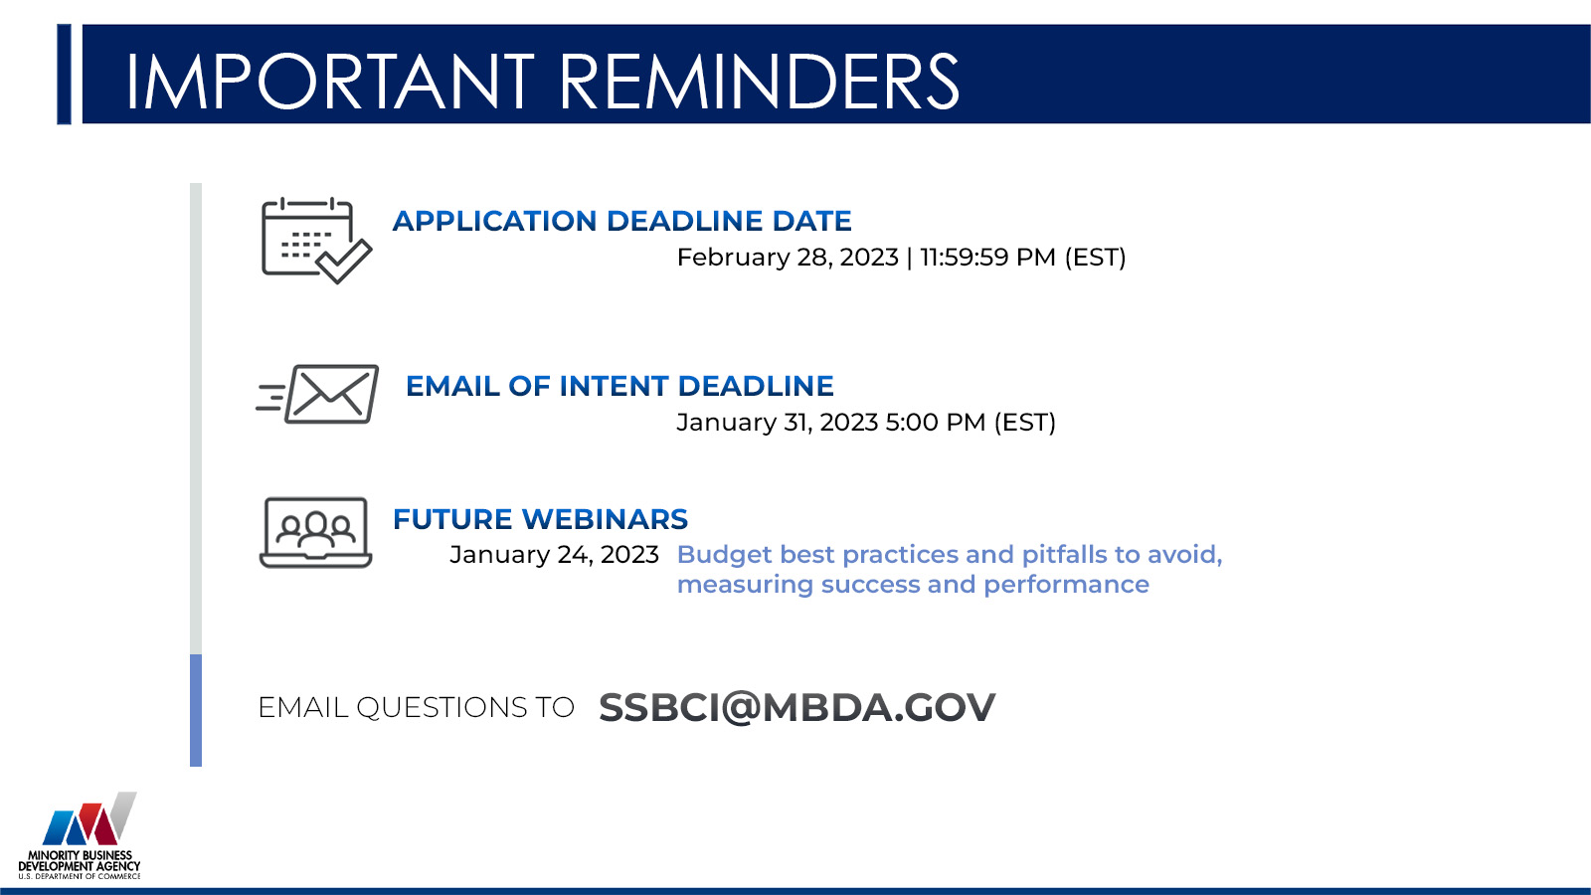

MISSED A PRE-APPLICATION WEBINAR?
Recordings and presentation slides are available at www.MBDA.gov
Click “learn more” on CAPITAL READINESS PROGRAM
Notes:
Efrain

