Slide 1
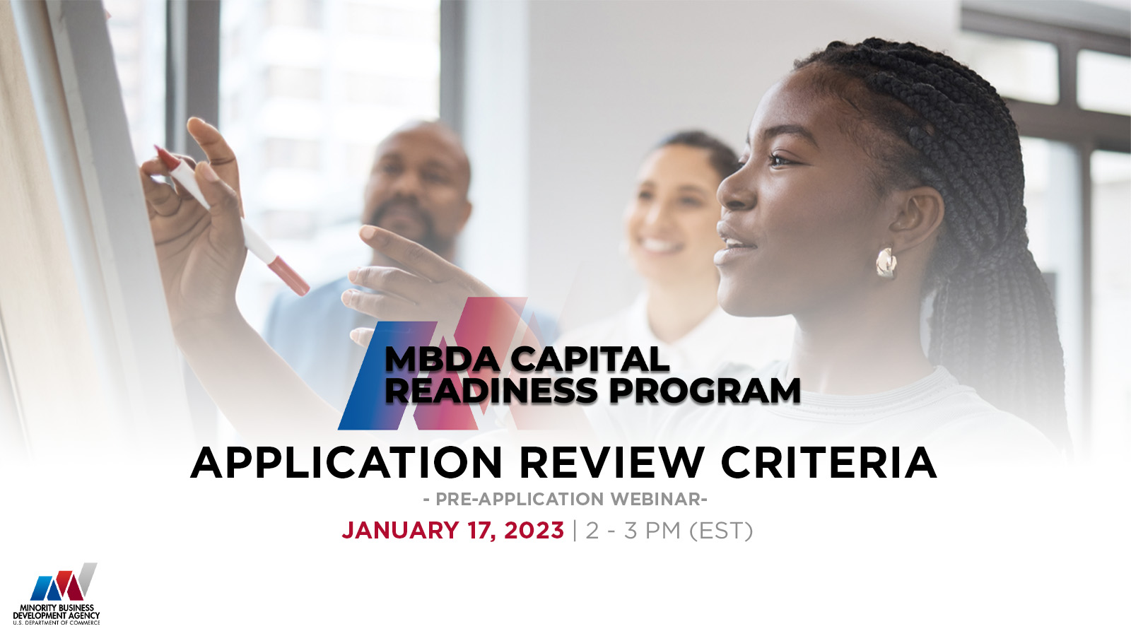

Slide 2
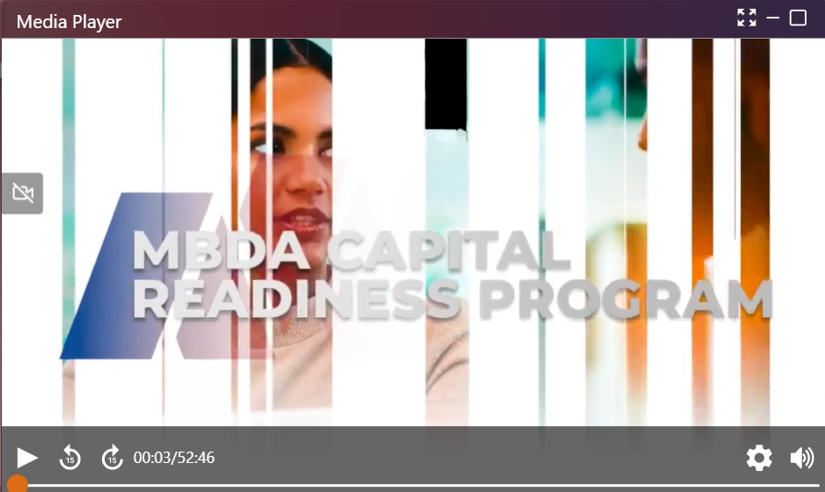
TECH TIPS FOR WEBINAR PLATFORM
IMPROVING VIDEO QUALITY
Webinars are bandwidth-intensive, close other applications/browsers that use bandwidth (e.g., Zoom, MS Teams, Webex, etc.)
ADJUSTING AUDIO
Control your volume, mute, and unmute from the lower right corner of the MEDIA PLAYER screen.

Slide 3
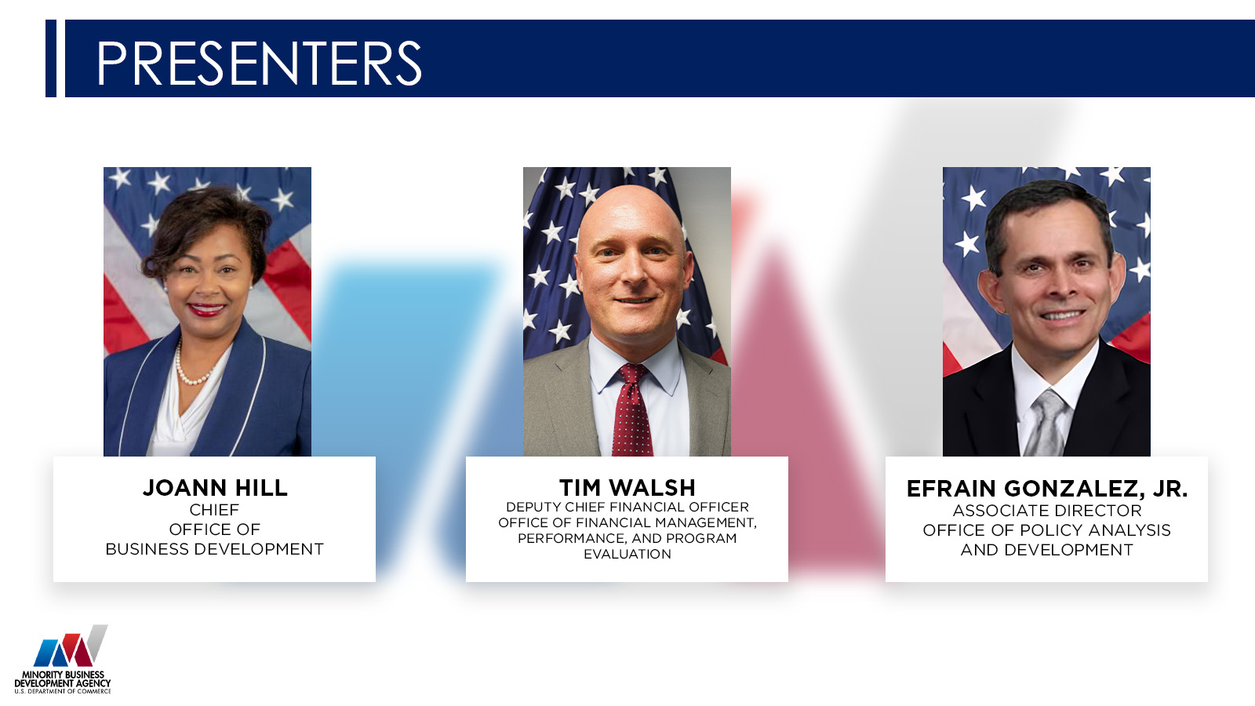

Slide 4
PRELIMINARY INFORMATION
This webinar is for informational purposes only and is intended solely to assist potential applicants in better understanding the MBDA Capital Readiness Program and the application requirements set forth in the Notice of Funding Opportunity (NOFO) for this program.
The information in this webinar does not and is not intended to supersede, modify, or otherwise alter applicable statutory or regulatory requirements or the specific application requirements set forth in the NOFO. In all cases, applicable statutory and regulatory mandates and the requirements set forth in the NOFO shall prevail over any inconsistencies presented in this Webinar.

Slide 5
PRELIMINARY INFORMATION
  This is a funding competition for technical assistance providers to provide services under the MBDA Capital Readiness Program
  This competition is not for individual entrepreneurs or small business owners to use the funds to grow their own businesses.
  If you are an entrepreneur or small business owner who needs help, please visit MBDA.gov to explore what current MBDA programs may fit your needs.

Slide 6
WEBINAR PROTOCOL
Submit all questions via the Q&A prompt.
Questions will be answered in writing throughout the webinar
We will also update the Frequently Asked Questions (FAQs) page with answers to questions
Keep questions relevant to the topic at hand

Slide 7
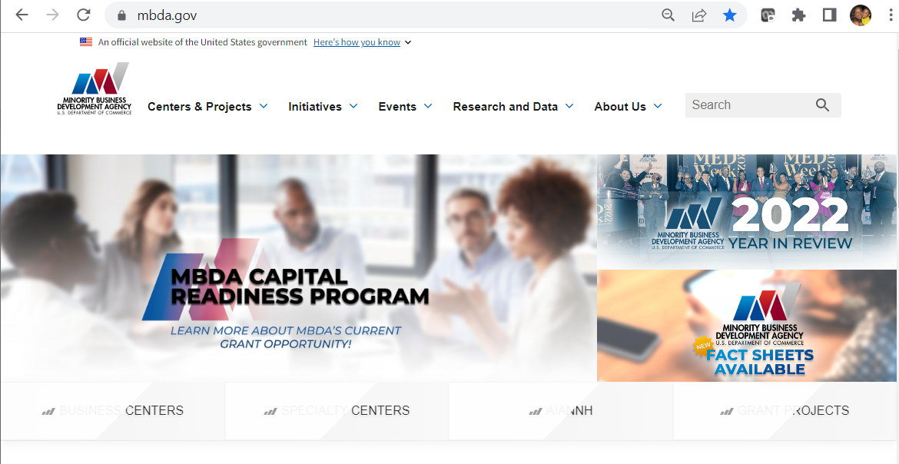
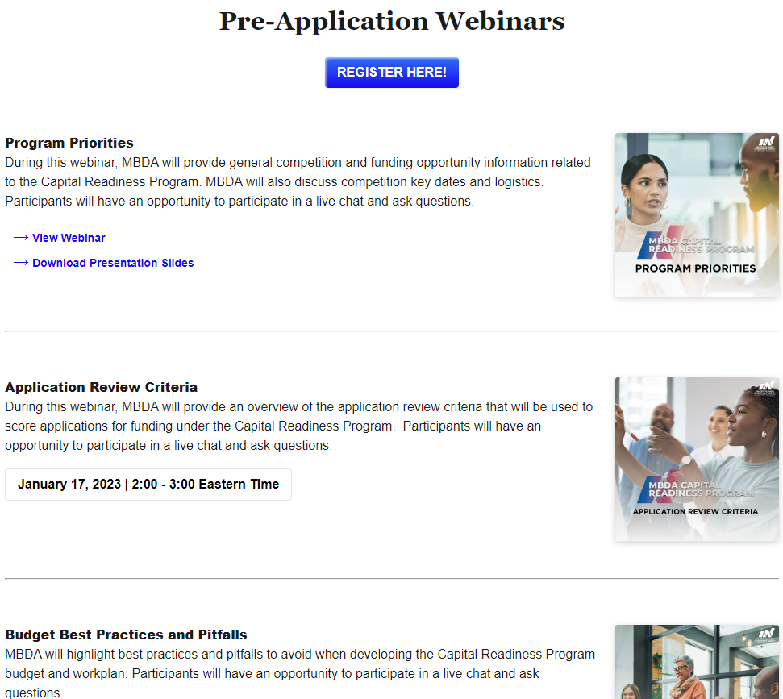
WEBINAR RECORDINGS
www.MBDA.gov

Slide 8
AGENDA
1. Capital Readiness Program (CRP) Overview
2. Notice of Funding Opportunity
3. Review and Selection Process
4. Merit Evaluation Criteria
5. Tips and Common Mistakes to Avoid
6. Questions and Answers
January 17, 2023

Slide 9


Slide 10
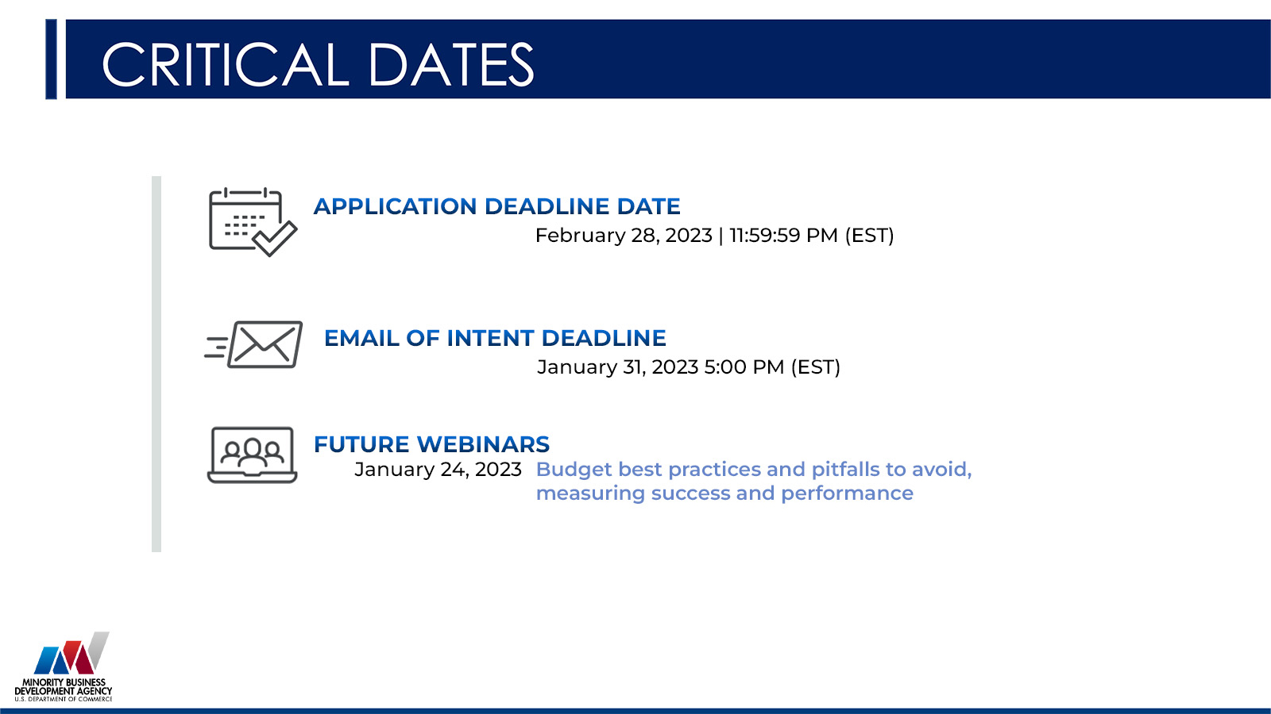

Slide 11

WHAT IS THE CAPITAL READINESS PROGRAM?
The MBDA Capital Readiness Program (Program) is designed to help close the entrepreneurship gap between socially and economically disadvantaged individuals (SEDI) and non-SEDI.
The Program seeks applications from qualified organizations that have the expertise to provide technical assistance for entrepreneurs starting or scaling their businesses who are seeking various forms of capital.
The competition seeks applicants that:
  help SEDI entrepreneurs build capacity;
  attract and provide access to capital opportunities; and
  attract and provide access to network
The services provided through MBDA’s Capital Readiness Program are intended to serve entrepreneurs and businesses that are applying to the Department of Treasury’s State Small Business Credit Initiative (SSBCI) or other government programs that support small businesses.
The Capital Readiness Program is funded by SSBCI, which provides $10 billion to states, territories, and Tribal Governments to promote entrepreneurship and increase access to capital.

Slide 12
SERVICE MODELS
Proposals must demonstrate activities that resemble service models of incubators or accelerators or provide a combination of both.
Incubators
Accelerators
Early Stage
Emerging Stage
Helping startups and early-stage entrepreneurs launch their businesses, products, and services.
Helping emerging businesses that have moved beyond the earliest stages and need more sophisticated guidance and peer support to scale their business.
MBDA strongly encourages applicants to include technical assistance for new entrepreneurs and/or businesses in the early stages of the business lifecycle as part of its offerings.
EXAMPLES OF SERVICE MODEL ACTIVITIES
see NOFO page 9

Slide 13
ELIGIBLE APPLICANTS
Non-profit organizations;
Private sector entities (defined as entities that are not public sector entities);
  This includes, for example, for-profit entities of any type, including sole-proprietorships, partnerships, limited liability companies, and corporations; but
  Does not include public sector entities, such as Federal, State, Local, or Tribal Governments, agencies, or any of their instrumentalities;
Institutions of higher education; and
A consortium of two or more of any of the above-mentioned eligible applicants
  In a consortium application, there must be a designated lead applicant; and
  The lead applicant would assume primary operational and financial responsibility for the project.
IMPORTANT NOTE: MBDA is not authorized to provide cooperative agreements to individuals under this NOFO, and such requests will not be considered for funding.

Slide 14


Slide 15
WHAT IS A NOFO?
A Notice of Funding Opportunity (NOFO):
Announces the grant opportunity
Contains details about the application requirements and procedures to request Federal funding for eligible projects
Contains the evaluation criteria that we're here to talk about today

Slide 16
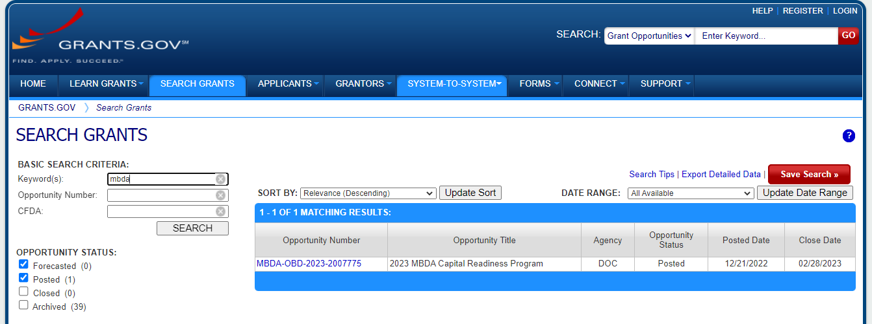
WHERE DO I FIND THE NOFO?
Click on the links on the MBDA website or search “mbda” on GRANTS.GOV:
Click the Opportunity Number
to see the Synopsis and the full NOFO text (under “Related Documents” tab)

Slide 17

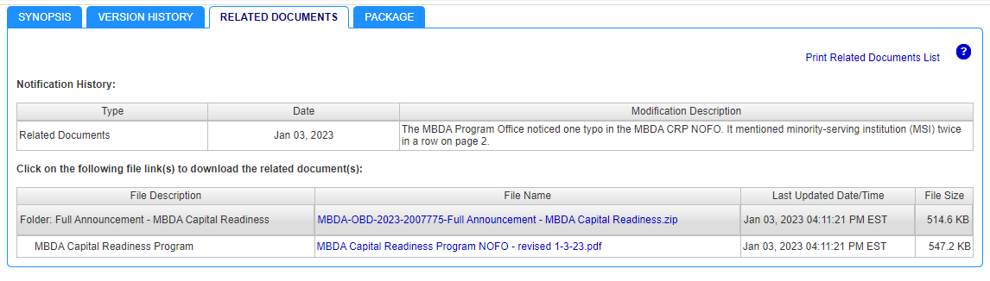

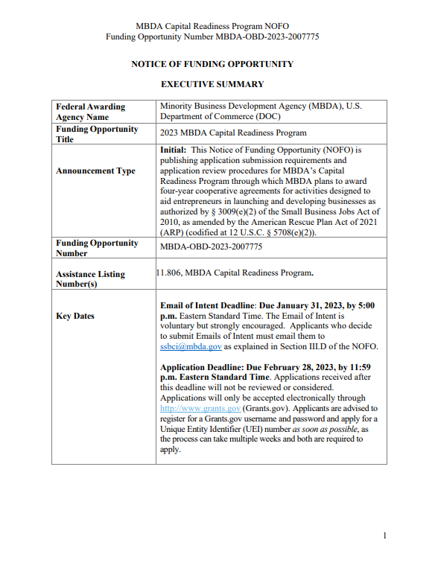
THE NOFO

Slide 18


Slide 19
APPLICATION REVIEW AND SELECTION PROCESS
1. Initial Screening (Technical Review)
Each application is reviewed for completeness and eligibility to determine which applications move to the evaluation stage.
2. Merit Review
Each complete and eligible application is evaluated by a panel of subject matter experts (Merit Review Panel) using the evaluation criteria outlined in the NOFO.
3. Selection Factor Review
Proposals that receive 65 or more points will be passed to the Selection Review Panel for consideration in light of the Selection Factors outlined in the NOFO. The Selection Review Panel will recommend a portfolio of proposals for funding to the Selecting Official, who retains ultimate decision-making authority.
4. Announcement
The anticipated time for processing awards is approximately 120 days from the receipt of applications.
Note: MBDA funding decisions are final and not subject to appeal.
Notes:
TIM

Slide 20
APPLICATION REVIEW AND SELECTION PROCESS
Application Review Steps – In-Depth Look
Initial Screening (Technical Review)
Merit Review
MBDA Selection Review Panel and Selection Factors
Each application will receive an initial administrative review to ensure all required forms, signatures, and documents are present. An application may not be evaluated by the review panel if:
The application is received after the closing date.
The application package does not contain mandatory items
The project fails to address program objectives and priorities (see Section I of the NOFO)

Slide 21
APPLICATION REVIEW AND SELECTION PROCESS
Review and Selection Process:
Each application will receive an independent review by the Merit Review Panel. The panel will consist of at least 3 qualified individuals.
Each reviewer will provide an individual score based on the NOFO requirements for a maximum of 110 points including bonus points.
Each application will receive a single score by averaging the scores of all reviewers.
Applications with an overall average of 65 points or higher will be considered for funding.
Applications with fewer than 65 points will not be considered.
Initial Screening (Technical Review)
Merit Review
MBDA Selection Review Panel and Selection Factors
Notes:
TIM

Slide 22
APPLICATION REVIEW AND SELECTION PROCESS
Project Narrative Outline
Initial Screening (Technical Review)
Merit Review
MBDA Selection Review Panel and Selection Factors
Proposals with 65 or more points will be passed to the Selection Review Panel that will be composed of no more than 5 Federal employees.
The Selection Review Panel may take into consideration one or more of the section factors detailed on pages 33 and 34 of the NOFO.
The Selection Review Panel will recommend a final portfolio of proposals, from which the successful applications may be selected.
The Selecting Official retains ultimate decision-making authority and may apply the selection factors listed in the NOFO to any application scoring 65 points or more.
Notes:
TIM

Slide 23

Notes:
TIM

Slide 24
WHAT ARE THE EVALUATION CRITERIA?
Criterion Project Goals and Proposed Solutions Organizational Capacity (Resources & Assets) Budget and Timeline Total Available Points (before Bonus Points) | Points 40 Points 40 Points 20 Points 100 Points

Slide 25
PROJECT GOALS AND PROPOSED SOLUTION
40 POINTS TOTAL (broken into specific sub-criteria)
This criterion considers the strength of the proposed activities under the three Program Pillars, the alignment of the proposal with the identified target participants’ (SEDI entrepreneurs) needs, and the strength of the proposal’s ability to drive SEDI participation in the project. Proposed goals should be specific, measurable, reasonable, and achievable during the grant period and beyond.
For this Program, a Socially and Economically Disadvantaged Individual (SEDI) entrepreneur is defined as an
entrepreneur who has had their access to credit diminished due to their:
  race or ethnicity - Federal/state-recognized Indian Tribe Members
  gender - long-term residence in a rural-community
  veteran status - residence in a U.S. Territory
  limited English proficiency - disability, and more
We encourage you to review the NOFO carefully for the full definition.
Notes:
TIM

Slide 26
PROJECT GOALS AND PROPOSED SOLUTION
Sub-criteria: Target Participants and their Needs
Clear identification of target participants (i.e., one or more SEDI groups) and demonstrated understanding of the barriers or gaps in capacity preventing the target participants from accessing capital (5 points)
  Tips:
    Who are you trying to reach? SEDI group(s), specific industries/market segments, maturity of business
    Think about the needs of the target participants and the barriers you're trying to address.
    Recognizing that the needs of various SEDI groups vary widely, applicants may design programs that target the needs of specific SEDI sub-groups.
    If your proposal plans to target the needs of specific SEDI groups, indicate which group(s) and why the location and proposed activities will effectively meet the needs of those group(s).
      If your organization has not historically served SEDI groups, don’t forget about strategic alliances!
    Note: while applicants may choose to design programming to address the needs of particular SEDI groups, service delivery must be in compliance with Title VI of the Civil Rights Act of 1964.
Carefully review the definition of SEDI on pages 7-8 of the NOFO

Slide 27
PROJECT GOALS AND PROPOSED SOLUTION
Sub-criteria: Capacity Building Pillar
The strength of the applicant’s proposed activities under the Capacity Building pillar of the Program (see Section I.A), including a clear statement backed by numerical data demonstrating how the applicant’s proposed activities will meet the needs of the target participants. This element includes the strength of the curriculum and MBDA’s goal to fund a comprehensive curriculum from which entrepreneurs can “graduate”, rather than one-off services. (10 points)
  Tips:
    Carefully review the Capacity Building pillar description and examples (page 9 of the NOFO).
    Clearly describe your curriculum and the proposed activities under your curriculum.
    Remember that MBDA is seeking to fund holistic programs for entrepreneurs. A multi-week curriculum that will “graduate” entrepreneurs will be more competitive.

Slide 28
PROJECT GOALS AND PROPOSED SOLUTION
Sub-criteria: Access to Capital Pillar
The strength of the applicant’s proposed activities under the Access to Capital pillar of the Program (see Section I.A), including a clear statement backed by numerical data demonstrating how the applicant’s proposed activities meet the needs of the target participants. This includes the strength of the applicant’s understanding of the capital ecosystem in the geographic location, industry, or market segment and the strength of the proposal’s plan to collaborate and/or connect program participants with Treasury’s SSBCI or other similar governmental programs. (10 points)
  Tips:
    Carefully review the Access to Capital pillar description and examples (pages 9-10 of the NOFO).
    Connect the proposed activities to the needs of the target participants.
    Explain your plan to connect entrepreneurs to Treasury’s SSBCI or other government programs that support small businesses.

Slide 29
PROJECT GOALS AND PROPOSED SOLUTION
Sub-criteria: Access to Networks Pillar
The strength of the applicant’s proposed activities under the Access to Networks pillar of the Program (see Section I.A), including a clear statement backed by numerical data demonstrating how the applicant’s proposed activities meet the needs of the target participants. This includes the strength of the applicant’s understanding of the business and professional networks in the geographic location, industry, or market segment and the strength of the proposal’s plan to connect Program participants to the network of professionals such as mentors, peers, subject matter experts, and service providers. (10 points)
  Tips:
    Carefully review the Access to Networks pillar description and examples (page 10 of the NOFO).
    Connect the proposed activities to the needs of the target participants.
    Think carefully about what networks could benefit SEDI entrepreneurs and how your project could help entrepreneurs build or join supportive and lasting networks.

Slide 30
PROJECT GOALS AND PROPOSED SOLUTION
Sub-criteria: Driving SEDI participation
The strength of the applicant’s strategies to drive SEDI participation in the project, including a clear statement backed by numerical data demonstrating how the applicant’s proposed activities and outreach strategy maximize the number of SEDIs served. This element may include the strength of the proposed alliances (as illustrated through Letters of Commitment and/or memoranda of understanding) and the strength of the proposal’s plan for outreach. (5 points)
  Tips:
    Think carefully about how you plan to reach the SEDI groups that you propose to serve.
    Provide numerical data about the geographic location(s), industry(ies), or market segment(s) you propose to serve.
    Explain your outreach plan and use numerical data to show how your plan to drive participation will succeed.
    If you have commitments from organizations who plan to help you, explain how those alliances will aid the project in this area.

Slide 31
ORGANIZATIONAL CAPACITY
40 POINTS TOTAL (broken into specific sub-criteria)
This criterion assesses whether the applicant has the resources and capacity to meet the needs of the target participants, define the target geographic area, industry, or market segment to be served, understand the community and business ecosystem’s assets, challenges and needs, and demonstrate they can leverage the strengths of other organizations. The criterion further assesses if the organization has the financial and management capacity to execute the project successfully.
  Tip:
    If your organization has not historically served SEDI groups, don’t forget about strategic alliances!

Slide 32
ORGANIZATIONAL CAPACITY
Sub-criteria: Serving target participants and serving SEDIs
An explanation of why the applicant is positioned to serve target participants’ needs and to execute the proposed project successfully. (10 points)
A clear explanation that demonstrates prior performance serving SEDI populations and driving SEDI participation in technical assistance programs. (10 points)
  Note: If the applicant has not historically served SEDIs, an applicant can meet this criterion by establishing an alliance with one or more SEDI-serving institutions. To meet this criterion via alliances, the applicant must clearly describe the alliance organization’s prior performance in technical assistance programs serving SEDIs and how the alliance will enable the applicant to effectively serve SEDIs, including driving participation. The applicant must include one or more letters of commitment signed by the SEDI-serving institution.
  Tips:
    Demonstrate WHY your organization is the right organization to execute your proposed project.
    For consortium applications, clearly identify the roles of the lead applicant and other applicant organizations. Show your combined capacity and experience.
    For applicants that have not historically served SEDI populations, you must have at least one letter of commitment. Letters with more detail about the institution’s willingness and ability to provide support to the applicant will be viewed as more competitive.

Slide 33
ORGANIZATIONAL CAPACITY
Sub-criteria: Track record
A clear explanation that demonstrates prior performance or organizational capacity providing technical assistance and/or capacity building to businesses and access capital and networks, including but not limited to assisting (1) early-stage businesses launch their business, product or service and/or (2) emerging-businesses that have moved beyond the earliest stages of getting established and need more sophisticated guidance and peer support to scale up the business with a view toward equity fundraising, selling the business, or filing for an initial public offering. Such demonstration includes, over the last five years, the organization’s capacity to provide access to capital, access to networks, and capacity building. (10 points)
  Tips:
    Highlight your track record of providing services under the three Program Pillars – capacity building, access to capital, and access to networks.
    Review page 9 of the NOFO for clarifications about the differences between the early-stage/incubator service model and the emerging businesses/accelerator service model. Remember that proposals must demonstrate how the applicant plans to provide services under one or both service models.
A detailed explanation of the organization’s operations and management strengths including the organizational structure that show its capacity to execute the proposed project successfully. To meet this sub-criterion, the applicant must also submit the resumes of the project director and key project staff who will deliver services. Applicants may also strengthen their proposals under criterion by providing a list of the applicant’s Board of Directors or other advisers that the applicant may draw on for operational or subject matter expertise. (10 points)

Slide 34
BUDGET AND TIMELINE
20 POINTS
The feasibility and strength of the budget narrative, particularly whether the budget narrative and staffing costs are reasonable and realistic for the proposed project. (10 points)
The feasibility of the project’s proposed goals, particularly whether the proposal demonstrates that the goals and activities are ambitious, realistic, achievable, and reasonable given the amount of funding requested by the proposal. (10 points)
  Tips:
    Applicants are required to establish annual numerical performance goals under each Performance Measure (see NOFO Appendix B).
    Identify the rationale for the proposed goals, including any key assumptions underlying the goals.

Slide 35
BONUS POINTS
Under this NOFO, an applicant may be awarded a maximum of 10 bonus points for the following MBDA strategic priorities. An applicant may receive up to 5 points for each of the following categories. An applicant may receive points under multiple categories, but the total amount of bonus points an applicant receives will be capped at 10 points.
BONUS POINT CATEGORIES:
Providing services in geographic areas that are rural in nature.
Providing childcare as a support for SEDI entrepreneurs. Please note that Program funds cannot be used to fund childcare activities as part of the proposal or as an eligible activity
Serving SEDI-owned businesses with a focus on market-driven solutions that provide greater resources to underserved communities, such as affordable housing solutions, food security, or climate-related technology or services
Serving SEDI-owned businesses with a focus on healthcare, biotechnology and biomanufacturing, asset management, artificial intelligence, information security, supply chain resiliency or management, semiconductors, cloud computing or another high growth critical emerging technology
Supporting Infrastructure Investment and Jobs Act (IIJA) and Inflation Reduction Act (IRA) Related Industries

Slide 36


Slide 37
TIPS AND COMMON MISTAKES TO AVOID
Begin the SAM registration process immediately.
Confirm the Authorized Organization Representative (AOR) profile is active as soon as possible.
Give yourself 5 or more days for application submission.
Ensure all required digital signatures are captured in the application.
Ensure budget figures are accurate and not rounded.
Ensure the prescribed format and sequence from the NOFO is used in your application.
Use plain English when writing.
Ensure your application is clear and concise.
OK to use footnotes when citing source data and research.
Double check your proposal before submission.

Slide 38
TIPS AND COMMON MISTAKES TO AVOID
The 20 page limit pertains to the Project Narrative and its components (see NOFO pp. 17-22)
The total proposal shall not exceed 30 pages and includes:
  Project abstract, project narrative, literature cited, budget narrative, project timeline, and organizational structure
The following are not included in the 30 page limit count:
  Resumes/bios of key personnel
  Required forms: SF-424, SF-424A, SF-424B, SF-LLL, CD-511
  Support Documents (see NOFO p.22), except for data/literature cited in the Project Narrative
  Matching Share Commitment (see NOFO pp.22-24)
  Indirect Cost Rate Agreement Documentation (see NOFO pp.24-25)

Slide 39
TIPS AND COMMON MISTAKES TO AVOID
MBDA is a performance based organization, as such, it is important that you include a description of the methodology or evidence and key assumptions used to construct and propose your goals (see NOFO p. 18)
Ensure you propose and define at least one additional performance measure that reflects the projects scope of work (see NOFO p. 12 and Appendix B)
Ensure you used a reasonable evidence-based approach when defining the project goals.
Define the project goals annually for each program year.
Adjust goals for start-up period.
For budget documentation, you must submit:
  One budget narrative that covers all 4 years of the project – discuss each year separately.
  One SF-424 form that covers all 4 years of the project.
  Four SF-424A forms, one for each year of the project

Slide 40


Slide 41
