Slide 1
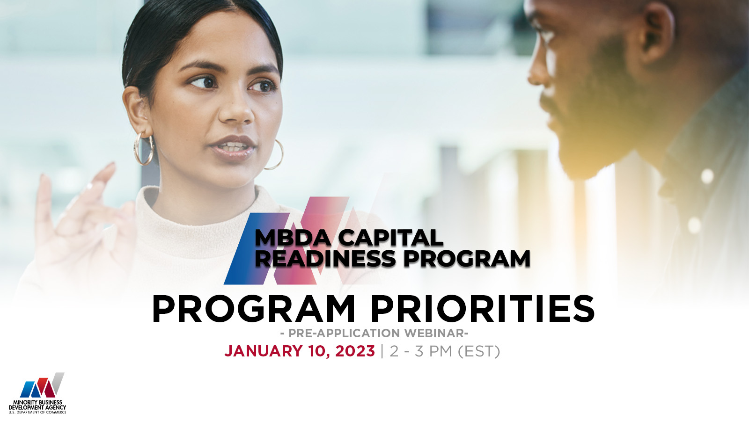

Slide 2
PRELIMINARY INFORMATION
This webinar is for informational purposes only and is intended solely to assist potential applicants in better understanding the MBDA Capital Readiness Program and the application requirements set forth in the Notice of Funding Opportunity (NOFO) for this program.
The information in this webinar does not and is not intended to supersede, modify, or otherwise alter applicable statutory or regulatory requirements or the specific application requirements set forth in the NOFO. In all cases, applicable statutory and regulatory mandates and the requirements set forth in the NOFO shall prevail over any inconsistencies presented in this Webinar.

Slide 3
PRELIMINARY INFORMATION
  This is a funding competition for technical assistance providers to provide services under the MBDA Capital Readiness Program
  This competition is not for individual entrepreneurs or small business owners to use the funds to grow their own businesses.
  If you are an entrepreneur or small business owner who needs help, please visit MBDA.gov to explore what current MBDA programs may fit your needs.

Slide 4
WEBINAR PROTOCOL
Submit all questions via the question prompt
Questions will be answered at end of the webinar
Answers to questions will also be published at www.MBDA.gov on the Capital Readiness Program Frequently Asked Questions (FAQs) page
Keep questions relevant to the topic at hand

Slide 5
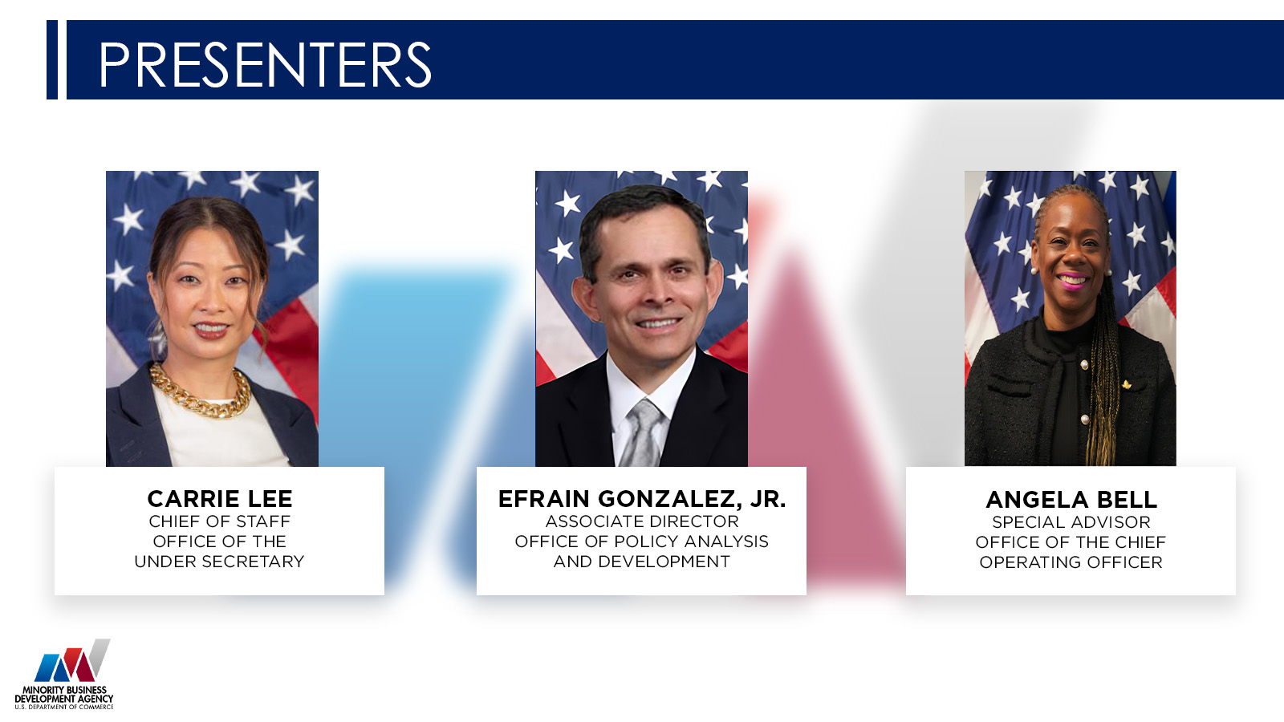

Slide 6
AGENDA
1. Capital Readiness Program (CRP) Overview
2. Notice of Funding Opportunity
3. How to Apply
4. Project Narrative Guidance
5. Questions and Answers
January 10, 2023

Slide 7
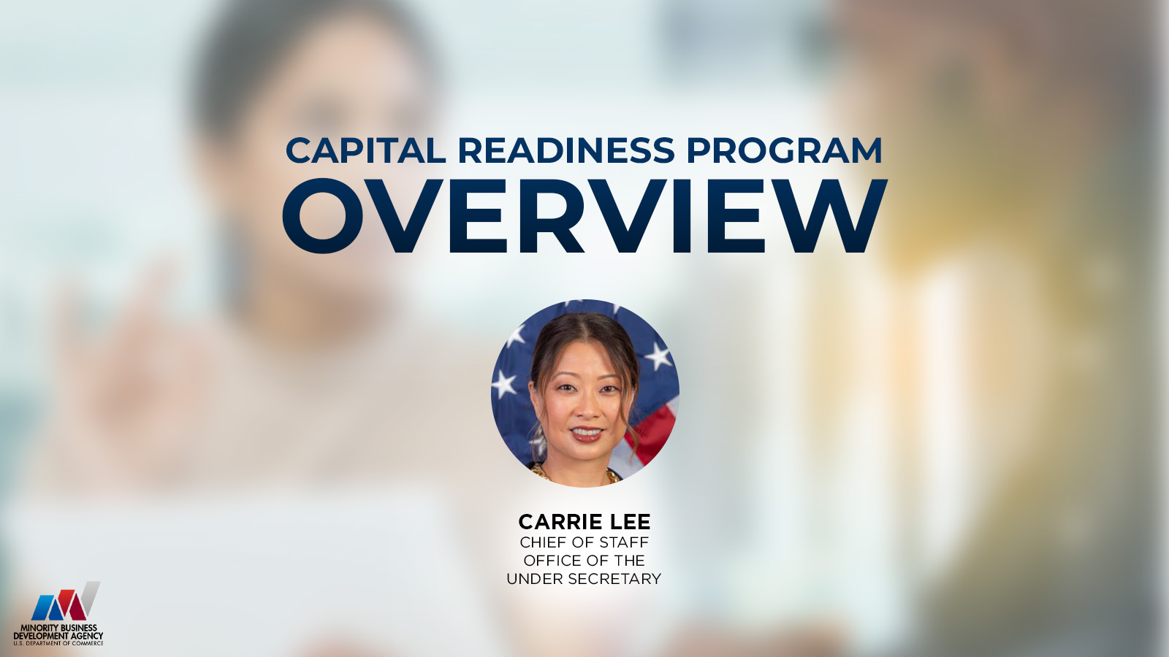

Slide 8
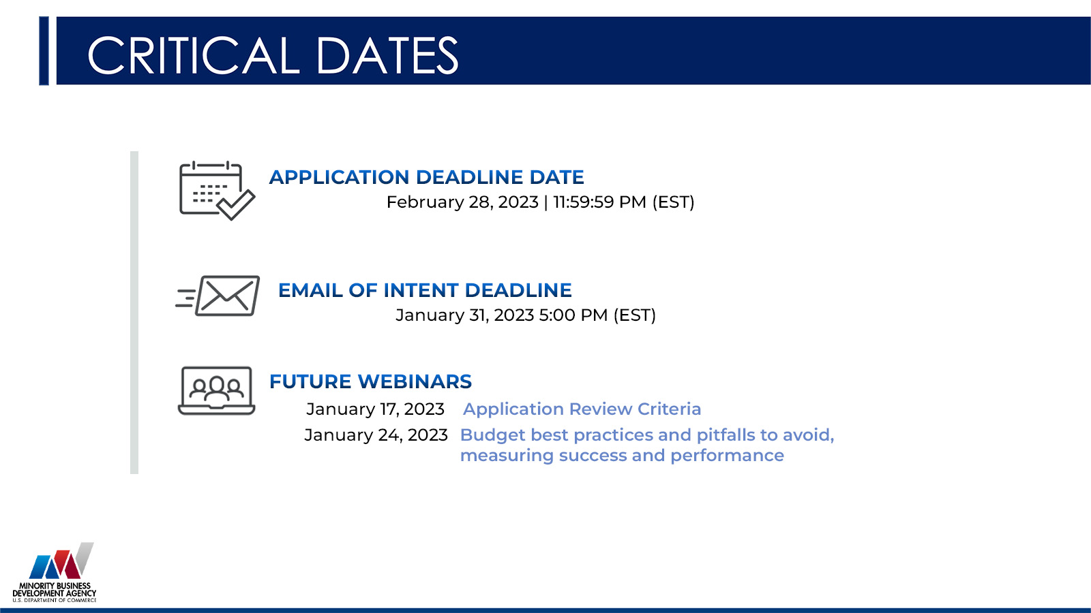

Slide 9

WHAT IS THE CAPITAL READINESS PROGRAM?
The MBDA Capital Readiness Program (Program) is designed to help close the entrepreneurship gap between socially and economically disadvantaged individuals (SEDI) and non-SEDI.
The Program seeks applications from qualified organizations that have the expertise to provide technical assistance for entrepreneurs starting or scaling their businesses who are seeking various forms of capital.
The competition seeks applicants that:
  help SEDI entrepreneurs build capacity;
  attract and provide access to capital opportunities; and
  attract and provide access to network
The services provided through MBDA’s Capital Readiness Program are intended to serve entrepreneurs and businesses that are applying to the Department of Treasury’s State Small Business Credit Initiative (SSBCI) or other government programs that support small businesses.
The Capital Readiness Program is funded by SSBCI, which provides $10 billion to states, territories, and Tribal Governments to promote entrepreneurship and increase access to capital.

Slide 10
LANDSCAPE
The fastest and broadest path to wealth is through entrepreneurship.
However, minority and underserved entrepreneurs lack resources for business formation and expansion.
THE GAP
THE POTENTIAL
01
Only 2% of businesses are black-owned.
Men own 3x the number of small businesses as women.
Black and LatinX founders receive only 2.4% of total venture funder funding. Black women less than .05%.
Black businesses pay a $250,000 premium to start the same business as a non-SEDI.
03
If Black-owned businesses were proportionate to the population, the US would see 738,000 more Black-owned businesses, 7 million more jobs, and $733 billion more in annual receipts.
IMPACT TO THE COMMUNITY
THE POTENTIAL
02
Entrepreneurship creates quality jobs specific to the needs of the community.
Without these jobs, family structures are stressed, crimes rise and neighborhoods decline.
Conversely, entrepreneurship can unleash a new era of business growth, job creation, and wealth.
04
If LatinX businesses were proportionate to the population, the US would see 884,500 more LatinX businesses, 7.5 million more jobs, and $1.2 trillion more in annual receipts.

Slide 11
CHALLENGES
Entrepreneurial inequity is a driving contributor to the racial wealth gap in the United States. Barriers are rampant throughout the entrepreneurial ecosystem.
Capital
Networks
Capacity
ACCESS TO CAPITAL
ACCESS TO NETWORKS
CAPACITY BUILDING
SEDI businesses start with half as much capital as non-SEDI firms and rely heavily on expensive personal debt. This disparity hinders equity fundraising and growth.
Business networks are often built informally among investors, and SEDI have not been able to easily tap into these networks of mentors, subject matter experts, vendors, peers and investors.
SEDI often have fewer tools and resources necessary to grow a start-up from pre-seed to exit.

Slide 12
OPPORTUNITIES
The Capital Readiness Program aims to provide services to close entrepreneurial gaps. Examples include:
Capital
Networks
Capacity
ACCESS TO CAPITAL
ACCESS TO NETWORKS
CAPACITY BUILDING
Assisting entrepreneurs with identifying government capital programs
Technical assistance
Facilitating investor meetings
Pitches
Demo days
Crowdfunding
Etc.
Facilitating strategic alliances
Mentorship relationships
Peer support
Attracting/training qualified workforce
Creating an advisory board
Cultivating stakeholders
Corporate partnerships
Etc.
Management training
Marketing training
Financial literacy
Financial planning
Accounting
Legal assistance
Startup bootcamps
Workforce development
Pre-accelerator workshops
Etc.

Slide 13
PROGRAM DESIGN
Proposals must demonstrate activities that resemble service models of incubators or accelerators or provide a combination of both.
Incubators
Accelerators
Early Stage
Emerging Stage
Helping startups and early-stage entrepreneurs launch their businesses, products, and services.
Helping emerging businesses that have moved beyond the earliest stages and need more sophisticated guidance and peer support to scale their business.
MBDA strongly encourages applicants to include technical assistance for new entrepreneurs and/or businesses in the early stages of the business lifecycle as part of its offerings.

Slide 14
ELIGIBLE APPLICANTS
Non-profit organizations;
Private sector entities (defined as entities that are not public sector entities);
  This includes, for example, for-profit entities of any type, including sole-proprietorships, partnerships, limited liability companies, and corporations; but
  Does not include public sector entities, such as Federal, State, Local, or Tribal Governments, agencies, or any of their instrumentalities;
Institutions of higher education; and
A consortium of two or more of any of the above-mentioned eligible applicants
  In a consortium application, there must be a designated lead applicant; and
  The lead applicant would assume primary operational and financial responsibility for the project.

Slide 15
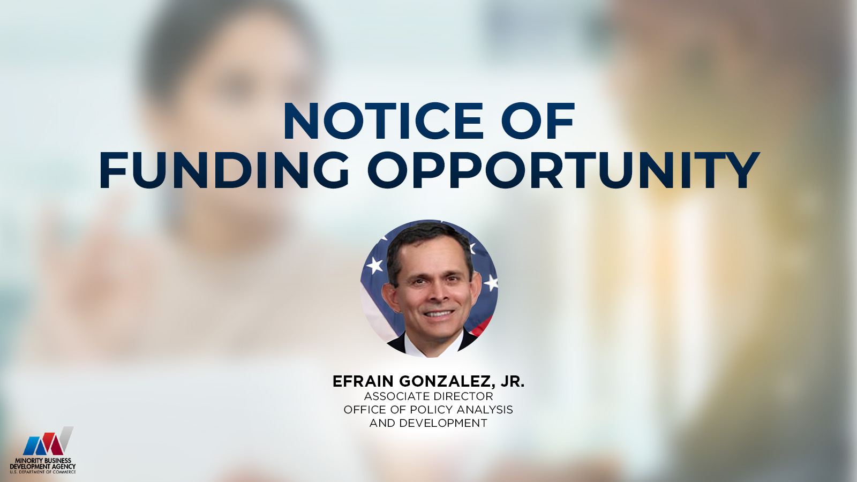

Slide 16
WHAT IS A NOFO?
A Notice of Funding Opportunity (NOFO):
Announces the grant opportunity
Contains details about the application requirements and procedures to request Federal funding for eligible projects

Slide 17
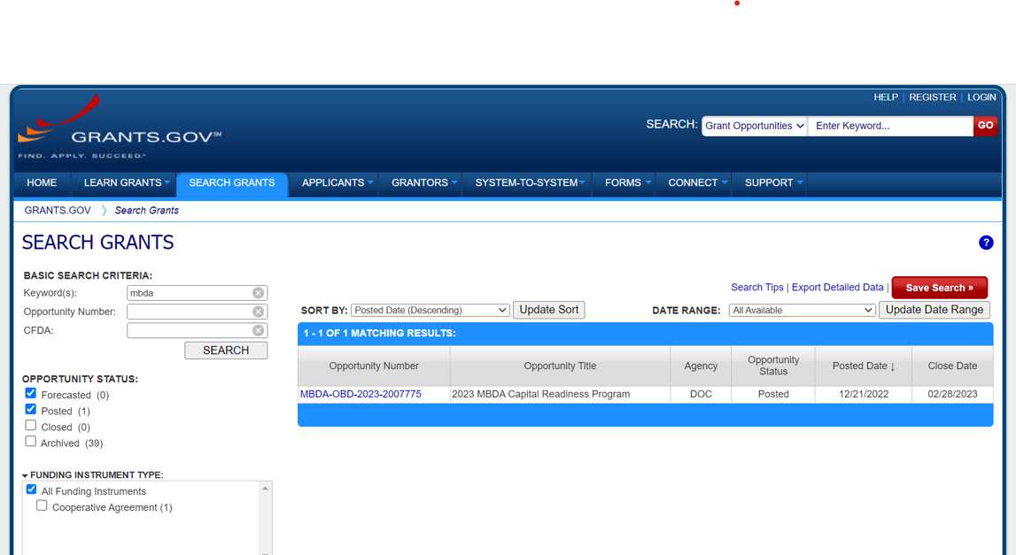
WHERE IS THE NOFO?
NOTE: Application deadline is
11:59:59 PM EST, Tuesday, February 28, 2023

Slide 18
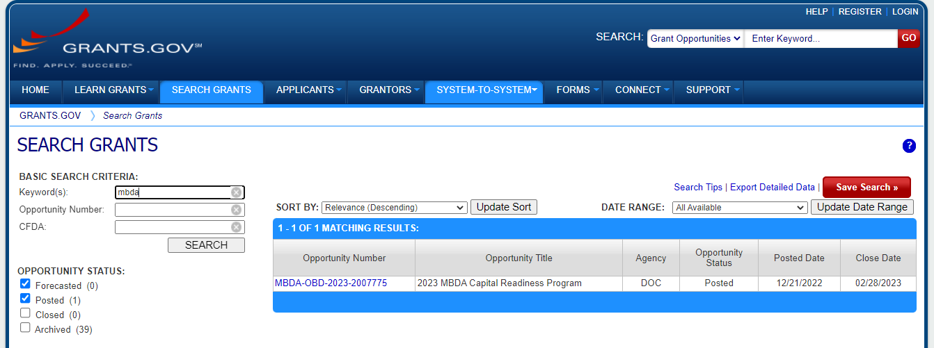
WHERE DO I FIND “HOW TO APPLY” INFORMATION?
Search grants on GRANTS.GOV:
Click the Opportunity Number
to see the Synopsis and the full NOFO text (under “Related Documents” tab)

Slide 19

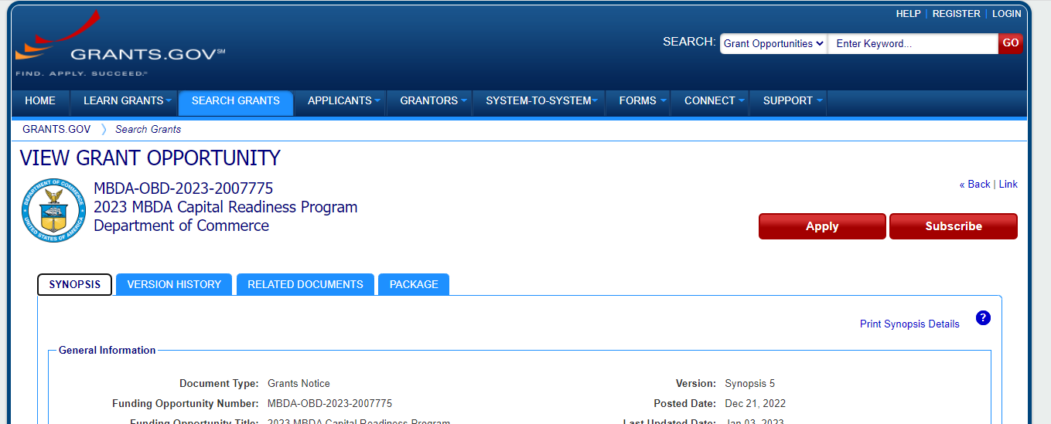
WHERE DO I FIND THE FULL TEXT OF THE NOFO?
To download the full PDF text of the NOFO, click on the “Related Documents” tab at the top or click on the “See Related Documents” link at the bottom of the Synopsis page on GRANTS.GOV.

Slide 20
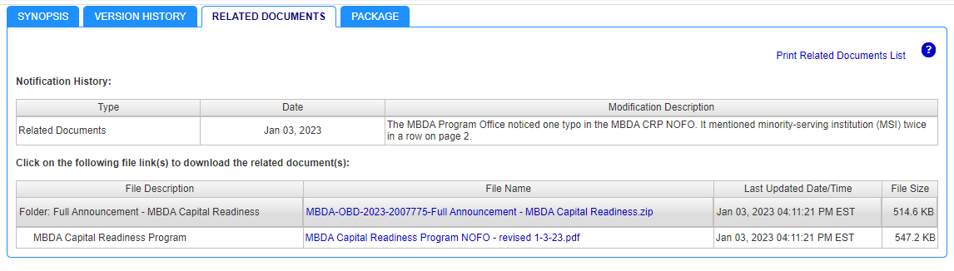

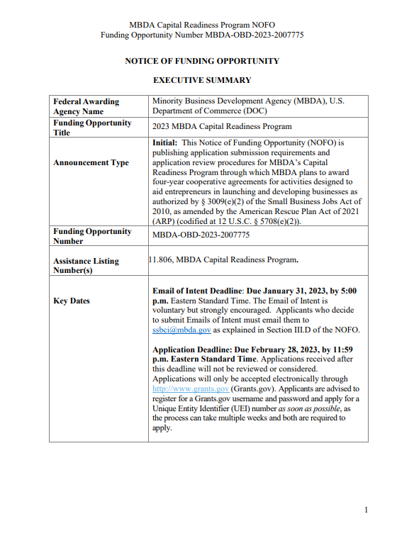
SAMPLE NOFO
January 10, 2023

Slide 21
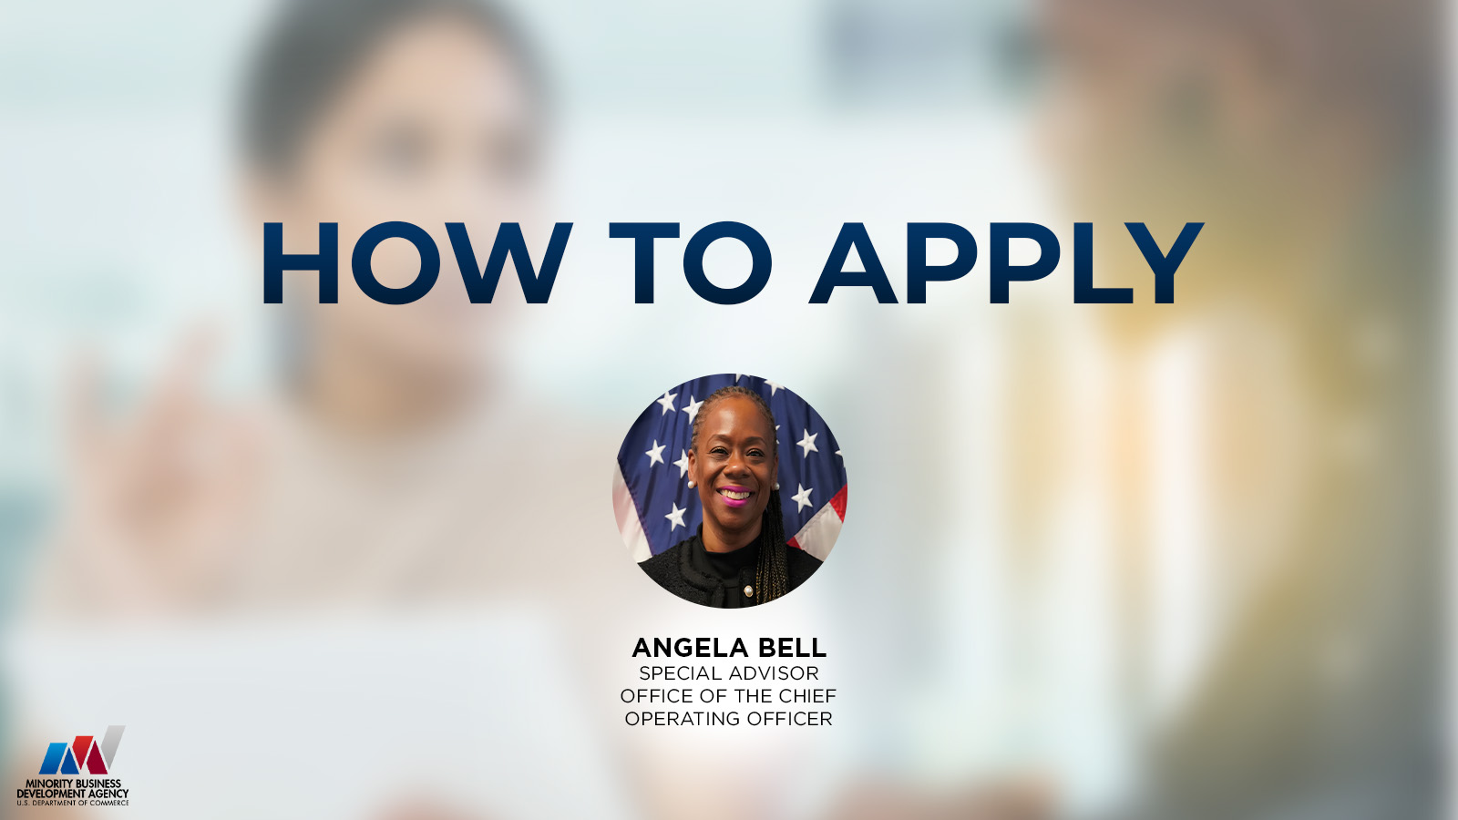

Slide 22
HOW DO I APPLY?
KEY STEPS
Obtain a Unique Entity Identifier (UEI) through SAM.gov
Register early in the Federal government's System for Award Management (SAM)
  NOTE: SAM registration can take up to 2 weeks (longer if you do not have an Employer Identification Number)
For GRANTS.GOV, complete an Authorized Organization Representative profile and create a username and password
Submit an application addressing all requirements outlined in the NOFO

Slide 23
WHAT DO I INCLUDE IN MY APPLICATION?
Project Abstract (one page limit)
Project Narrative (20-page limit)
Supporting Documents (i.e., letters of commitment, resumes)
Standard Forms
  SF-424 (Application for Federal Assistance)
  SF-424A (Budget Information Non-Construction Programs)
  SF-424B (Assurances for Non-Construction Programs)
  CD-511 (Certification Regarding Lobbying)
  SF-LLL (Disclosure of Lobbying Activities)
Budget Narrative
Letters of Commitment (from applicants who are working with other organizations with strong track records of working with SEDI)
Indirect Cost Rate (ICR) Agreement Documentation (if applicable)

Slide 24
Other Important Program Requirements
NON-FEDERAL MATCH REQUIREMENTS
Non-federal match ranging from 10% to 25% depending on the award amount
Reference Sections II.A and III.B of the NOFO for important rules governing non-federal cost share/matching requirement
Tier Level | Yearly Budget Amount | Required Non-Federal Share | Estimated Total Federal Funding (Over Four Years) | Estimate Total Non-Federal Share (Over Four Years)
Tier 1 | Up to $500,000 | 10% | Up to $2,000,000 | Up to $200,000
Tier 2 | From $500,001 to $625,000 | 15% | From $2,000,001 to $2,500,000 | From $300,001 to $375,000
Tier 3 | From $625,001 to $750,000 | 25% | From $2,500,001 to $3,000,000 | From $625,001 to $750,000

Slide 25
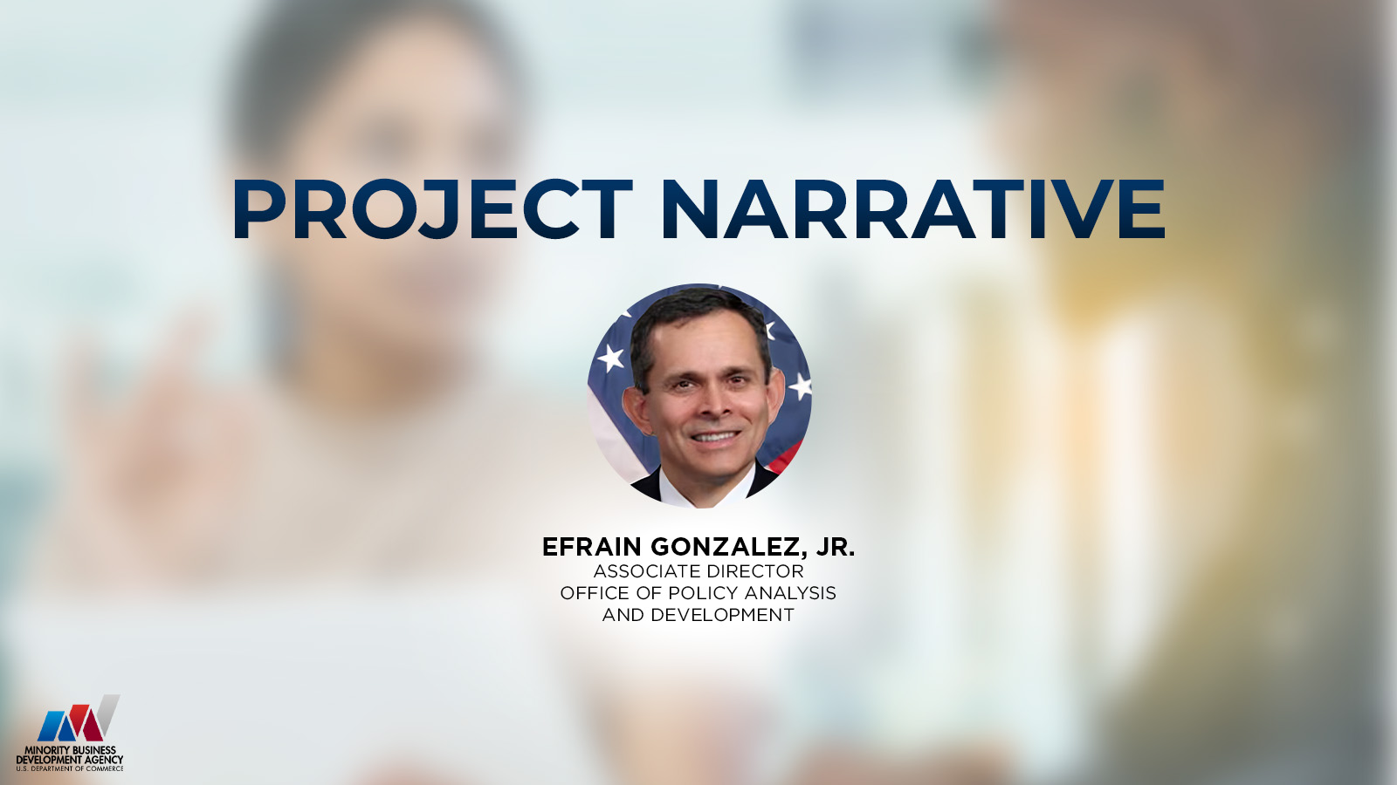

Slide 26
BEST PRACTICES – PROJECT NARRATIVE
Project Narrative Outline
Project Description
Location, Industry and/or Market Segment
Target Participants
Project Implementation Timeline
Project Activities, Goals and Objectives
Networks and Collaboration with the Capital Ecosystem
Applicant Capability
Sustainability
Structure your project narrative in accordance with the outline specified in the NOFO
Include all elements identified in the outline
Follow the instructions for each element
Adhere to 20-page limit

Slide 27
BEST PRACTICES – PROJECT NARRATIVE
Project Narrative Outline
Project Description
Location, Industry and/or Market Segment
Target Participants
Project Implementation Timeline
Project Activities, Goals and Objectives
Networks and Collaboration with the Capital Ecosystem
Applicant Capability
Sustainability
Fully describe and explain what is being proposed
Provide an executive summary of the program of no more than 250 words

Slide 28
BEST PRACTICES – PROJECT NARRATIVE
Project Narrative Outline
Project Description
Location, Industry and/or Market Segment
Target Participants
Project Implementation Timeline
Project Activities, Goals and Objectives
Networks and Collaboration with the Capital Ecosystem
Applicant Capability
Sustainability
Indicate the specific geographic service area and region where project activities will be implemented
Provide a clearly defined explanation of the area’s demographics, assets and needs
If you plan to focus on a particular industry or market segment that spans multiple geographic areas, you must demonstrate a plan to serve multiple geographic areas

Slide 29
BEST PRACTICES – PROJECT NARRATIVE
Project Narrative Outline
Project Description
Location, Industry and/or Market Segment
Target Participants
Project Implementation Timeline
Project Activities, Goals and Objectives
Networks and Collaboration with the Capital Ecosystem
Applicant Capability
Sustainability
Clearly identify the target participants, including:
  what SEDI group(s) needs are being targeted,
  industry or market segment focus,
  maturity of entrepreneur/businesses served (i.e., “incubator” and/or “accelerator” model), and
  method of technical assistance delivery (i.e., in-person, virtual, or hybrid)

Slide 30
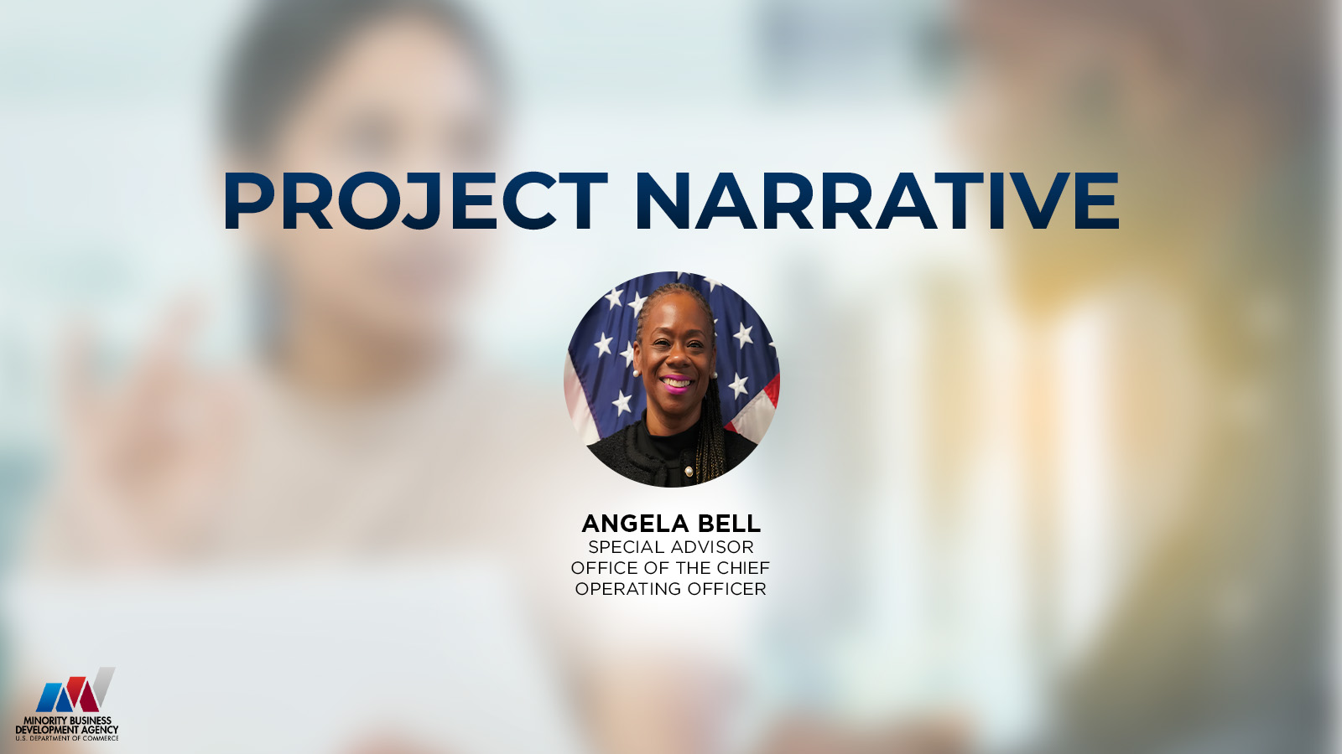

Slide 31
BEST PRACTICES – PROJECT NARRATIVE
Project Narrative Outline
Project Description
Location, Industry and/or Market Segment
Target Participants
Project Implementation Timeline
Project Activities, Goals and Objectives
Networks and Collaboration with the Capital Ecosystem
Applicant Capability
Sustainability
Provide a timeline over the period of performance (four years) with progressive annual milestones describing how the applicant will accomplish the project.
Include a detailed plan for the first 120 days describing the program ramp-up activities.

Slide 32
BEST PRACTICES – PROJECT NARRATIVE
Project Narrative Outline
Provide the proposed numeric project goals in the categories that will be tracked (see Appendix B of the NOFO for required categories)
For each proposed goal, include a description of the methodology or evidence and key assumptions that were used to construct and propose the goals.
Describe in detail the activities and services it will undertake to address each of the three Program Pillars.
Describe in detail what economic and investment opportunities are available
Describe in detail the specific outreach strategies the applicants and/or its partners will use
Describe in detail how the project is aligned with the needs of the target participants
Project Description
Location, Industry and/or Market Segment
Target Participants
Project Implementation Timeline
Project Activities, Goals and Objectives
Networks and Collaboration with the Capital Ecosystem
Applicant Capability
Sustainability

Slide 33
BEST PRACTICES – PROJECT NARRATIVE
Project Narrative Outline
Project Description
Location, Industry and/or Market Segment
Target Participants
Project Implementation Timeline
Project Activities, Goals and Objectives
Networks and Collaboration with the Capital Ecosystem
Applicant Capability
Sustainability
The applicant should present information that describes its networks in the target geographic region, industry, and/or market segment
The applicant should include a detailed plan as to how the applicant will collaborate or connect with participating jurisdiction(s), and/or government programs supporting small businesses and build a referral system for program participants.

Slide 34
BEST PRACTICES – PROJECT NARRATIVE
Project Narrative Outline
The applicant must present information demonstrating its experience and qualifications to leverage national or regional assets. The application should include the following information:
Applicant Profile
Applicant Track Record working with SEDI entrepreneurs (or strategic alliance organization’s track record)
Applicant Background working with Businesses and/or Entrepreneurs
Organizational Structure, Biographies or Resumes for Key Personnel
Disclosure of Pending or Completed Investigations, Lawsuits or Findings
Project Description
Location, Industry and/or Market Segment
Target Participants
Project Implementation Timeline
Project Activities, Goals and Objectives
Networks and Collaboration with the Capital Ecosystem
Applicant Capability
Sustainability

Slide 35
BEST PRACTICES – PROJECT NARRATIVE
Project Narrative Outline
Project Description
Location, Industry and/or Market Segment
Target Participants
Project Implementation Timeline
Project Activities, Goals and Objectives
Networks and Collaboration with the Capital Ecosystem
Applicant Capability
Sustainability
The applicant should describe the lasting impact of the proposed solution and its long-term benefits.
See the NOFO for a non-exhaustive list of possible examples of lasting impact.

Slide 36


Slide 37
